Slide 1

Hawkeye
Final presentation
Huang Yiqi (A0285711A) Zhang Zhen (A0285880N) Li Jiacheng (A0285823W)
Li Xin (A0285850W)
Zhao Xiang (A0285703B)
Notes:
Hi Professor. We are group 3 and my name is Zhao Xiang. Let me introduce our project. The name of our project is HAWKEYE, and here below are my team members.

Slide 2
Outline
1. Introduction
Project Background
Business Value
2. Technical Overview
Data Preprocessing
Model Architecture
Tasks
Object Dection & Tracking
Drivable Segmentation
Lane Segmentation
3. Wrap-up
Conclusions
Limitations & Future Work
Notes:
Here’s our content page. Firstly we’ll introduce our project and its business value. Then we’ll present our technical overview, including data processing, model architecture, and tasks. And finally, the last part is conclusions.

Slide 3
Part 1 - Introduction
Why we build the Project "Hawkeye"

Slide 4
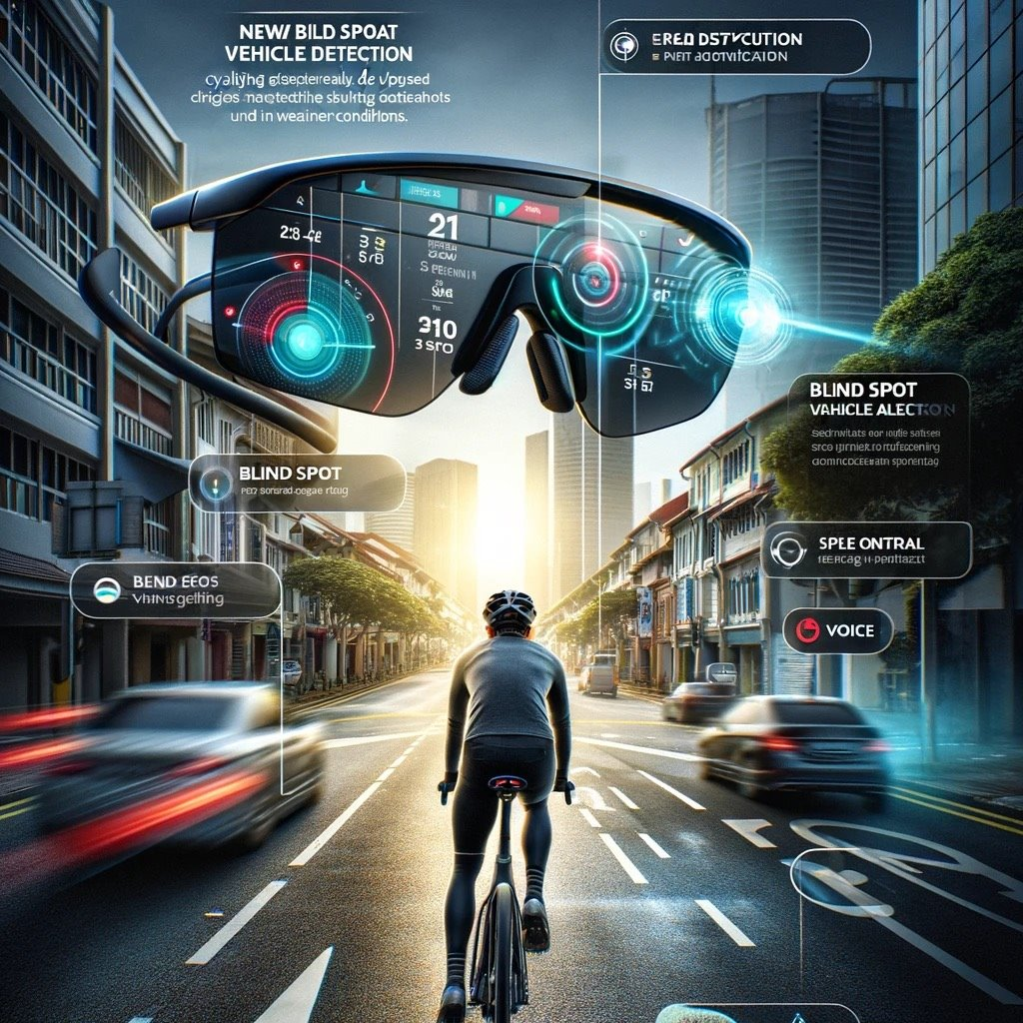
Project Introduction
Augmented Reality Eyewear
Enhance their safety on the road
Address the critical safety challenges cyclists face
Tracking
Lane Detection
Object Detection
Detecting potential hazards
Notes:
Our project presents an Augmented Reality (AR) eyewear, a system designed specifically to enhance cyclists' safety and navigation capabilities on the road.
Unlike conventional cycling aids, which often lack real-time responsiveness, our AR eyewear integrates advanced detection and assistance technologies into a single, easy-to-use platform for cyclists and personal mobility device users.

Slide 5


Business Problem Statement
Business Problem
Cyclist Safety Issue
Environment Issue
Usefulness
Safety Enhancement
Environment Friendly
User Experience
Impact on Singapore
Enhanced Cyclist Safety
Promotion of Sustainable Transportation
Public Health and Well-being
Notes:
As for the business problem statement, in 2023, there were more than six hundred cyclist accidents happened in Singapore.
Simultaneously, the interest in sustainable transportation is growing.
Our focus? Improving cyclist safety and promoting low-carbon travel. The benefits? Safer streets and a healthier environment.

Slide 6
Product Aim
Aims:
To develop a multi-faceted smart cycling assistant system that enhances the safety and navigation capabilities for riders.
To integrate advanced detection and assistance technologies into a user-friendly platform for cyclists and mobility device users.
To create a system that improves situational awareness and decision-making in real-time traffic environments.

Slide 7
Part 2 – Technical Implementations
The Technical Breakdown

Slide 8
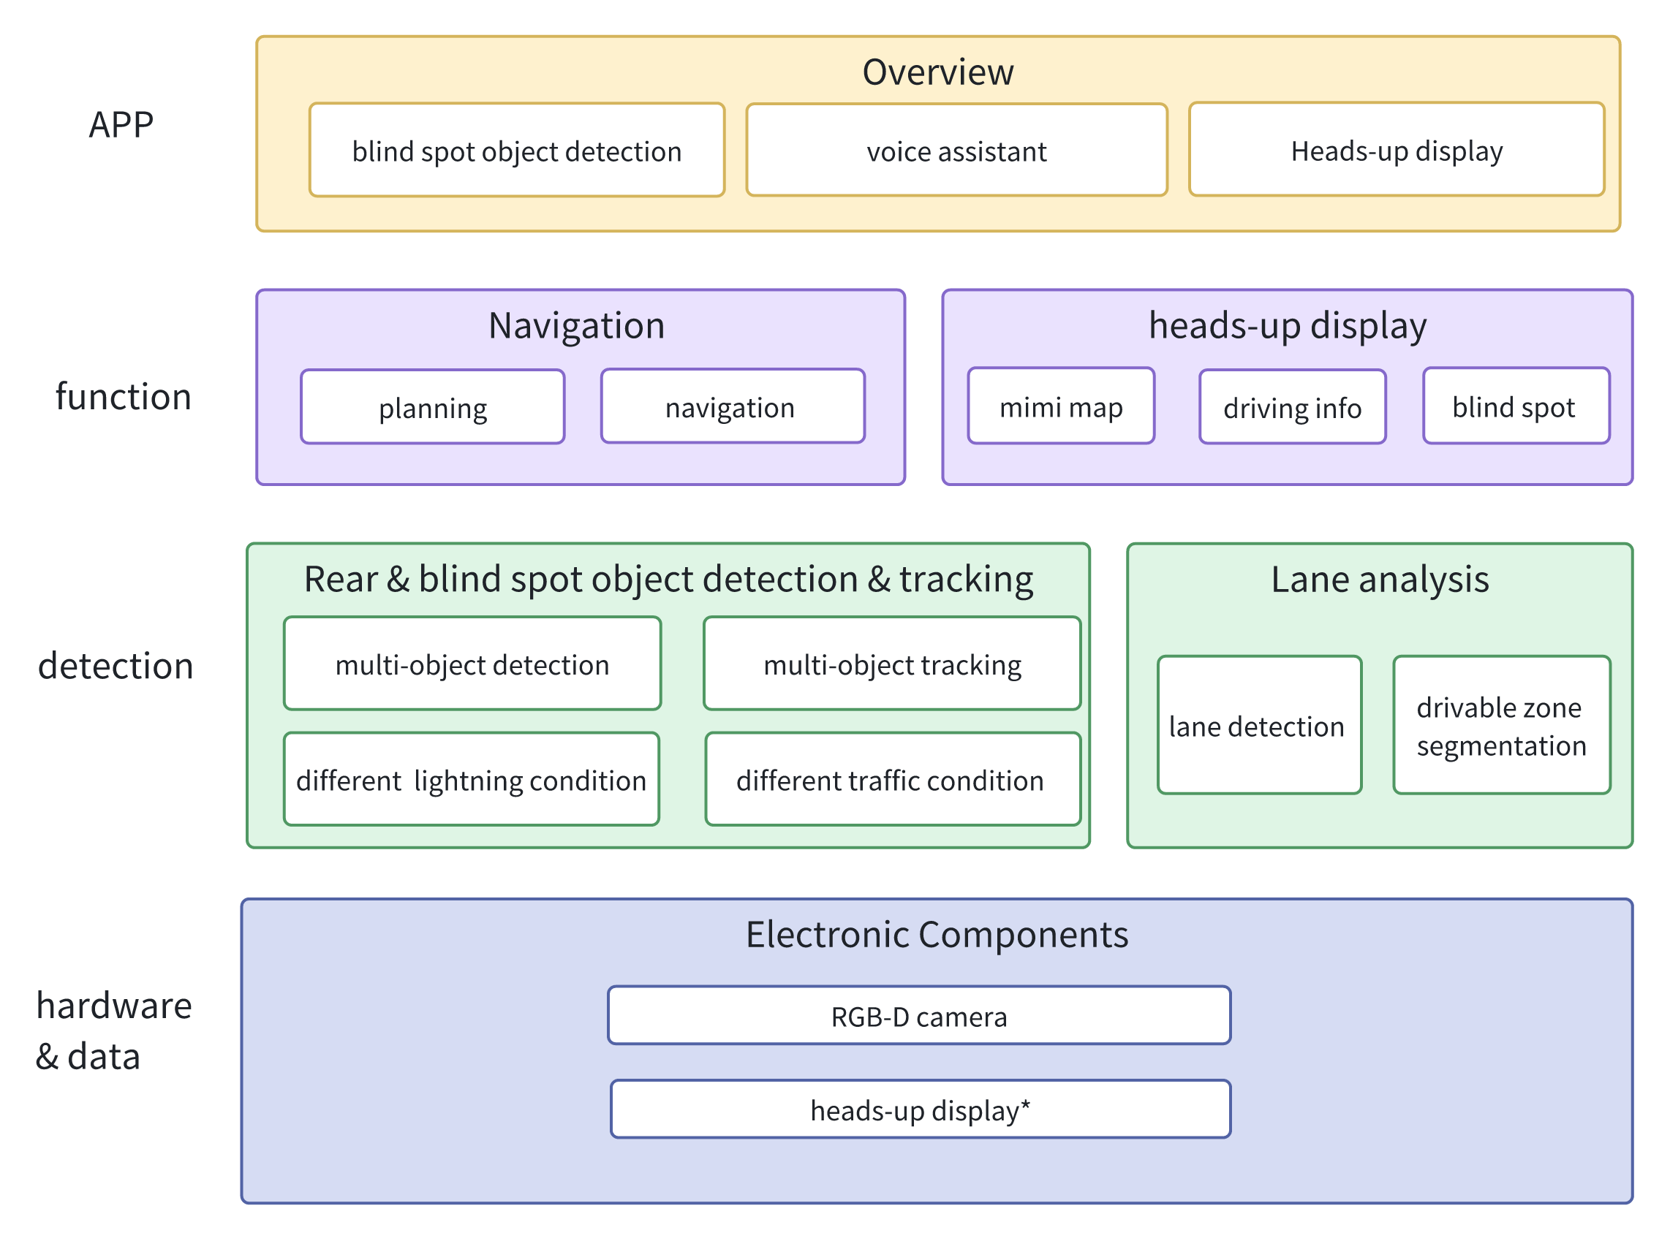
2. Technical approach overview

Slide 9
2.1 Data Briefing
Label Conversion
Detection labels
Bounding Box Coordinate to YOLO format
Segmentation labels
Drivable
Run-Length-Encoded segmentation mask
BDD100k Json to YOLO
Normalization
Lane
Polylines interpolation
BDD100k Json to YOLO
Normalization
Notes:
### Dataset Preprocessing Slide Content
#### Label Conversion
##### Detection:
- **Bounding Box Coordinate to YOLO format**
- **Objective**: Convert the raw bounding box coordinates from the dataset into the YOLO format for efficient training and detection.
- **Steps**:
1. Extract the bounding box coordinates (xmin, ymin, xmax, ymax).
2. Calculate the width (w) and height (h) of the bounding box.
3. Compute the center coordinates (x_center, y_center) of the bounding box.
4. Normalize the coordinates by dividing by the image width and height.
5. Format the data as (class_id, x_center, y_center, w, h).
##### Segmentation:
###### Drivable Areas:
- **Json to YOLO**:
- **Objective**: Transform segmentation data from JSON format to YOLO format for consistent data handling.
- **Steps**:
1. Parse JSON files to extract drivable area polygons.
2. Convert polygons into a suitable format for YOLO training.
3. Normalize the coordinates based on image dimensions.
- **Normalization**:
- **Objective**: Ensure all coordinates are within the [0, 1] range.
- **Steps**:
1. Divide each coordinate by the respective dimension (width or height).
2. Adjust the data to fit within the YOLO framework.
###### Lane:
- **Polylines interpolation**:
- **Objective**: Convert lane polylines into a format usable by YOLO.
- **Steps**:
1. Extract lane points from JSON files.
2. Interpolate points to create smooth polylines.
3. Normalize the points to fit within the image dimensions.
- **Json to YOLO**:
- **Objective**: Convert lane data from JSON to YOLO format.
- **Steps**:
1. Parse JSON files to extract lane markings.
2. Transform the lane data into a format suitable for YOLO.
3. Normalize the coordinates.
- **Normalization**:
- **Objective**: Standardize the coordinates to the [0, 1] range.
- **Steps**:
1. Normalize each coordinate by the image dimensions.
2. Ensure compatibility with YOLO’s requirements.
This preprocessing ensures that our dataset is accurately formatted for efficient training and detection, enabling robust performance in various conditions encountered by cyclists.

Slide 10
2.1 Data Briefing (cont.)
Type | Train | Validation | Description
Image (1280x720) | 70,000 | 30,000 | Sample images
Object Detection | 69,853 | 10,000 | Detection bounding boxes labels
Drivable Segmentation | 66,921 | 9,546 | Drivable area segmentation masks
Lane Segmentation | 66,640 | 9, 526 | Lane segmentation polygon labels
Notes:
### Dataset Preprocessing Slide Content
#### Label Conversion
##### Detection:
- **Bounding Box Coordinate to YOLO format**
- **Objective**: Convert the raw bounding box coordinates from the dataset into the YOLO format for efficient training and detection.
- **Steps**:
1. Extract the bounding box coordinates (xmin, ymin, xmax, ymax).
2. Calculate the width (w) and height (h) of the bounding box.
3. Compute the center coordinates (x_center, y_center) of the bounding box.
4. Normalize the coordinates by dividing by the image width and height.
5. Format the data as (class_id, x_center, y_center, w, h).
##### Segmentation:
###### Drivable Areas:
- **Json to YOLO**:
- **Objective**: Transform segmentation data from JSON format to YOLO format for consistent data handling.
- **Steps**:
1. Parse JSON files to extract drivable area polygons.
2. Convert polygons into a suitable format for YOLO training.
3. Normalize the coordinates based on image dimensions.
- **Normalization**:
- **Objective**: Ensure all coordinates are within the [0, 1] range.
- **Steps**:
1. Divide each coordinate by the respective dimension (width or height).
2. Adjust the data to fit within the YOLO framework.
###### Lane:
- **Polylines interpolation**:
- **Objective**: Convert lane polylines into a format usable by YOLO.
- **Steps**:
1. Extract lane points from JSON files.
2. Interpolate points to create smooth polylines.
3. Normalize the points to fit within the image dimensions.
- **Json to YOLO**:
- **Objective**: Convert lane data from JSON to YOLO format.
- **Steps**:
1. Parse JSON files to extract lane markings.
2. Transform the lane data into a format suitable for YOLO.
3. Normalize the coordinates.
- **Normalization**:
- **Objective**: Standardize the coordinates to the [0, 1] range.
- **Steps**:
1. Normalize each coordinate by the image dimensions.
2. Ensure compatibility with YOLO’s requirements.
This preprocessing ensures that our dataset is accurately formatted for efficient training and detection, enabling robust performance in various conditions encountered by cyclists.

Slide 11
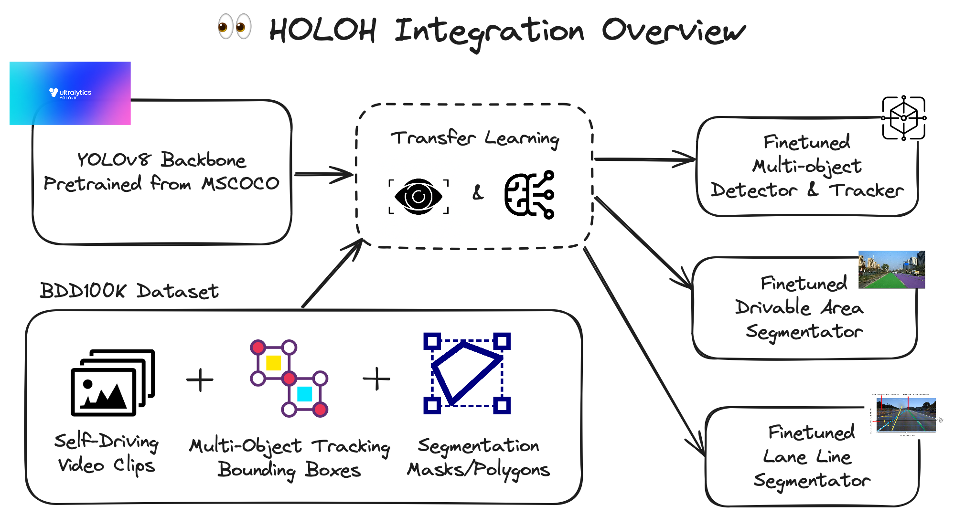
2.2.1 Training Procedure

Slide 12
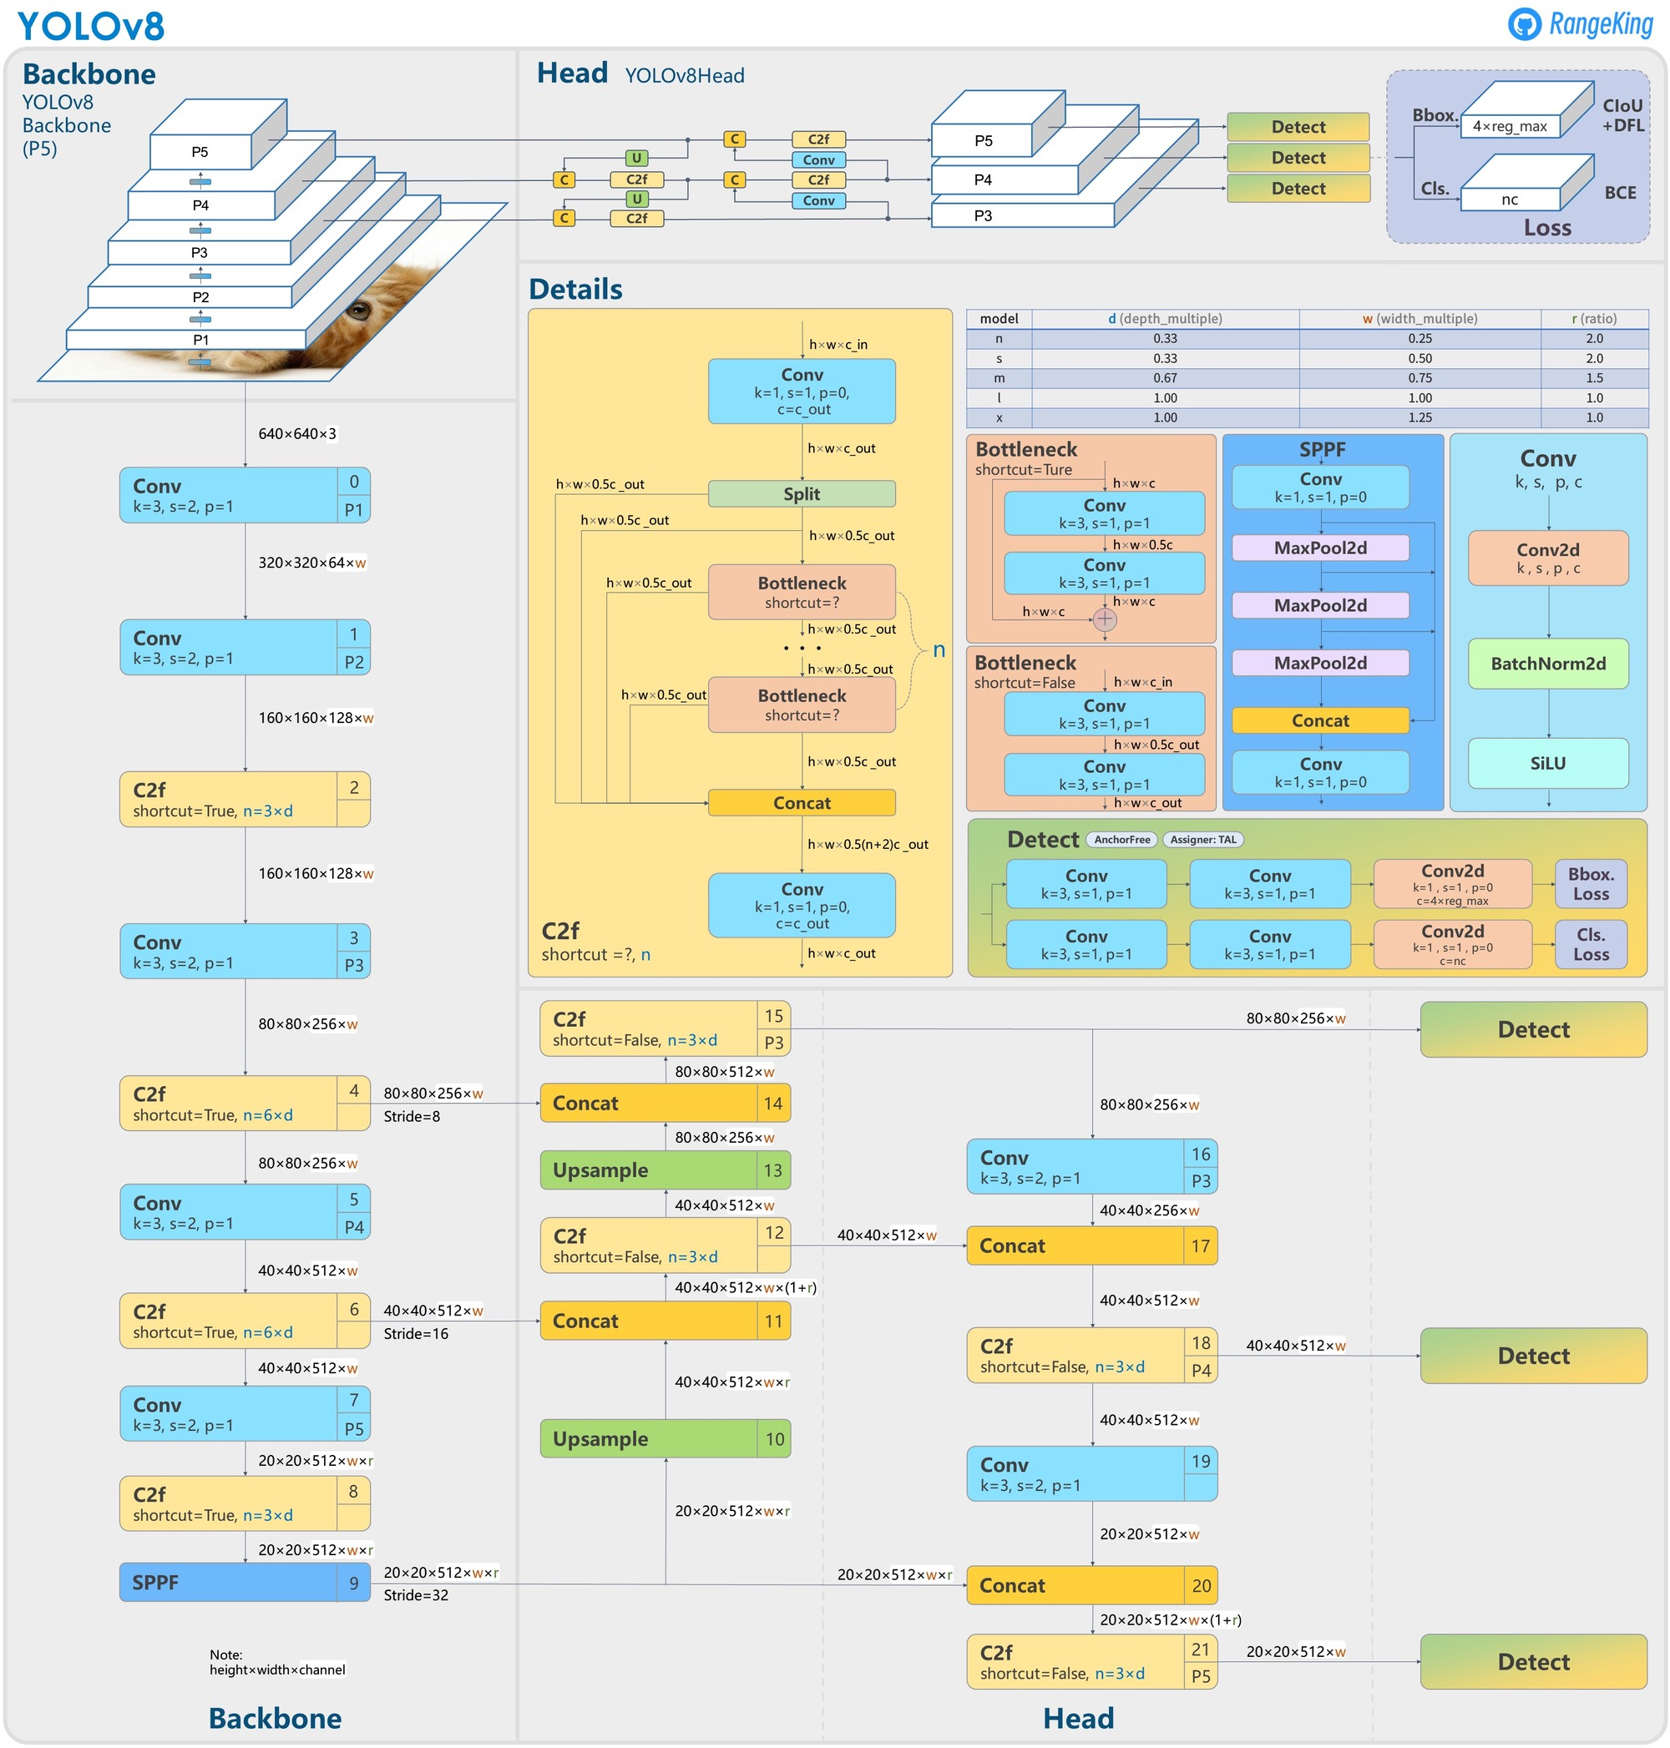
2.2.2 Model Architecture
HOLOH
- "Hawkeye YOLO Helper"
We apply transfer learning techniques and finetune different sub-tasks' models on YOLOv8 backbone.
It can be applied to :
Multi-object detection
Multi-object tracking
Drivable area segmentation
Lane segmentation

Slide 13
2.3.1 Multi-Object Dection
Pre-trainng: Initialize YOLOv8 with pre-trained weights from the Coco dataset to leverage extensive training on a diverse set of images.
Fine-Tuning: Fine-tune the model on our pre-processed BDD100K dataset, which includes images specifically tailored to our application.
Strategies Tested:
Zero-shot inference
Full training of all layers
Fine-tuning only the object detection head
Fine-tuning the last layer of the detection head while freezing the rest of the parameters
Epochs Experimentation: train different epochs to determine the optimal duration for the best performance.

Slide 14
2.3.1 Object Dection Results
Ex.No | epochs | mAP50 | MAP50-95 | Precision | Recall
Zero-shot | - | 2.7 | 0.52 | 3.4 | 3
Freeze head | 1 | 4 | 1.7 | 14.5 | 5.2
Freeze head With 40 epochs | Best 19th epoch | 23 | 12.5 | 65.7 | 22.6
Freeze backbone | 1 | 11 | 5.8 | 26.4 | 13.1
Freeze backbone With 40 epochs | best 18th epoch | 23 | 12 | 65.8 | 22.5
Page 14

Slide 15
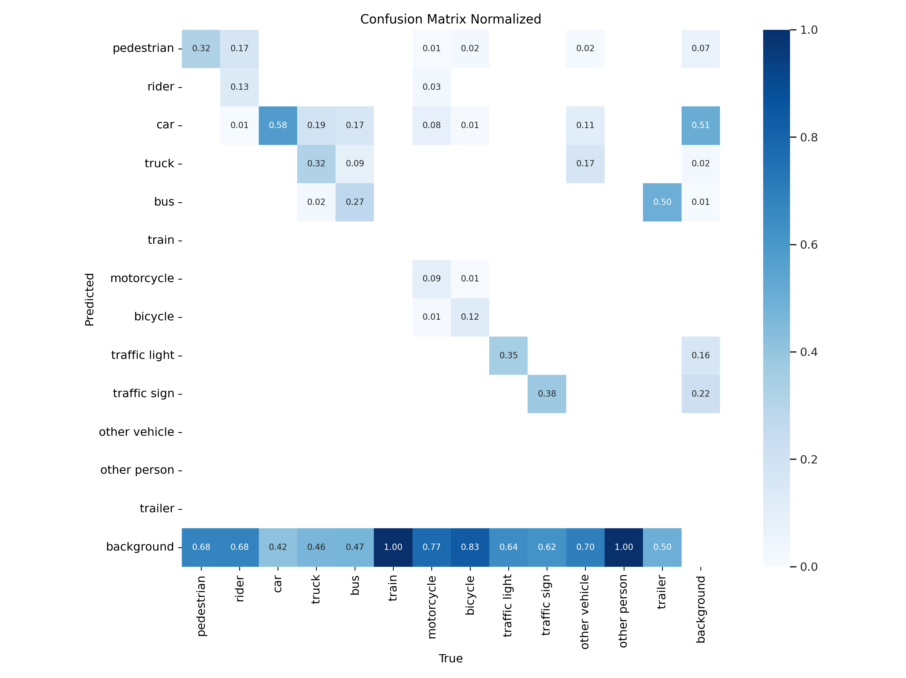
2.3.1 Object Dection
Page 15

Slide 16
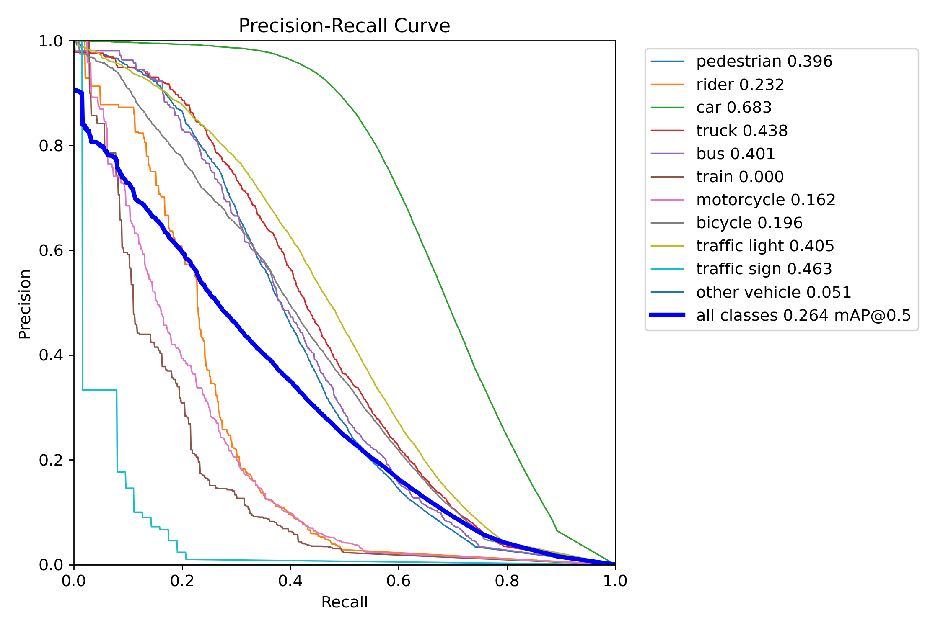
2.3.1 Object Dection
Page 16

Slide 17
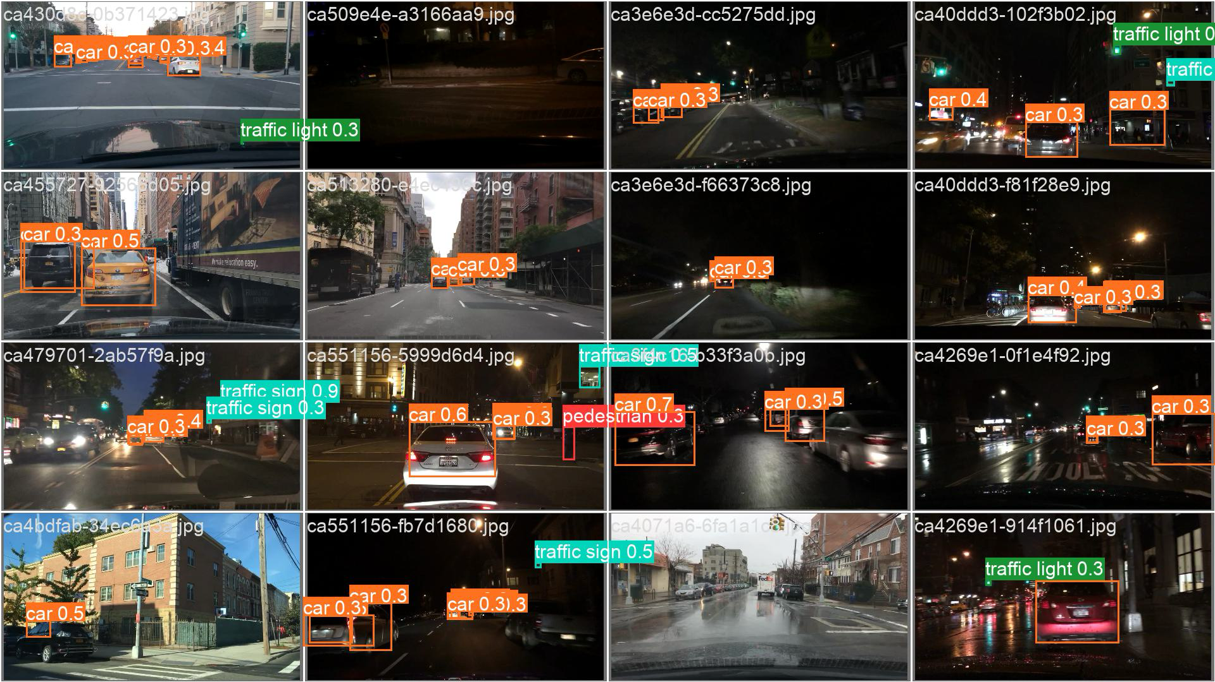
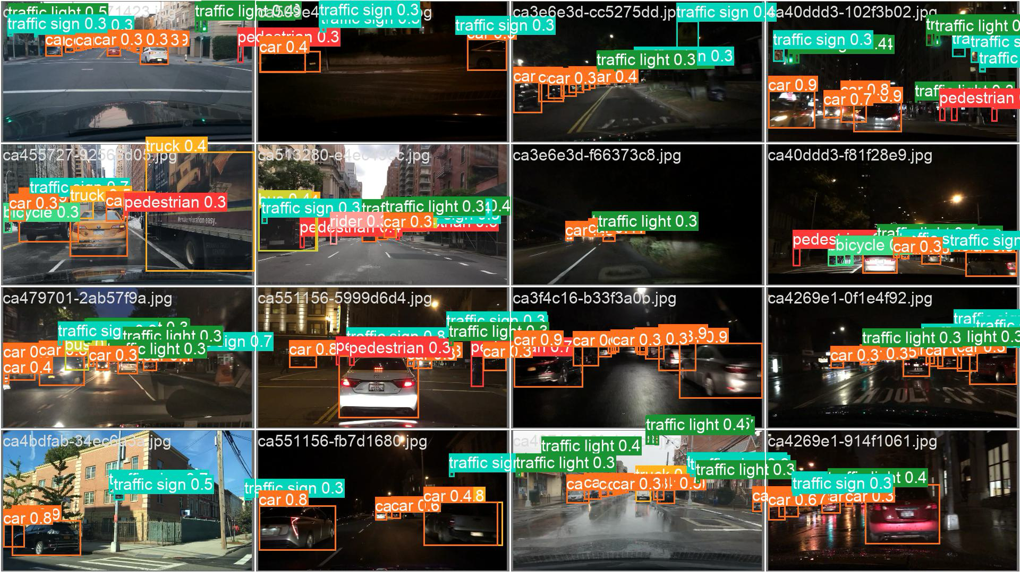
2.3.1 Object Dection
Fine-tune output layer with 1 epoch
Fine-tune output layer with 30 epoch
Page 17

Slide 18
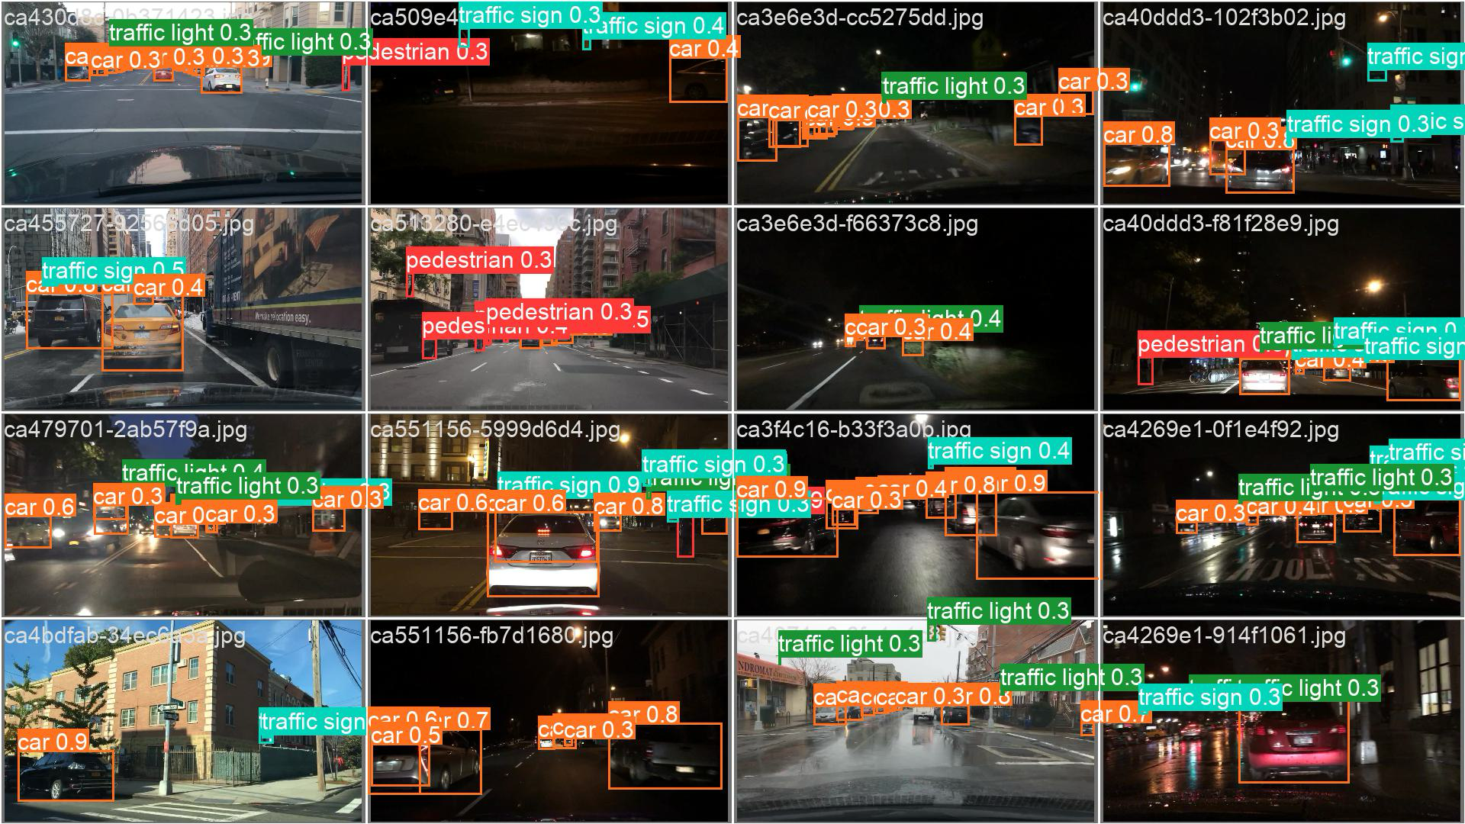
2.3.1 Object Dection Results
Fine-tune all detection head with 1 epoch
Fine-tune all detection head with 30 epoch
Page 18

Slide 19
2.3.2 Tracking
Detection and Initialization:
Utilized YOLOv8 for object detections, providing bounding boxes and class probabilities. BoT-SORT initializes these detections with unique IDs for tracking.
Position Prediction and Data Association:
Used a Kalman filter for position prediction. Employed the Hungarian algorithm, combining appearance features from a CNN and motion prediction for accurate data association.
Handling Occlusions and Reidentification:
Managed occlusions with predicted positions and reidentified objects when they reappeared, ensuring continuous and accurate tracking.

Slide 20
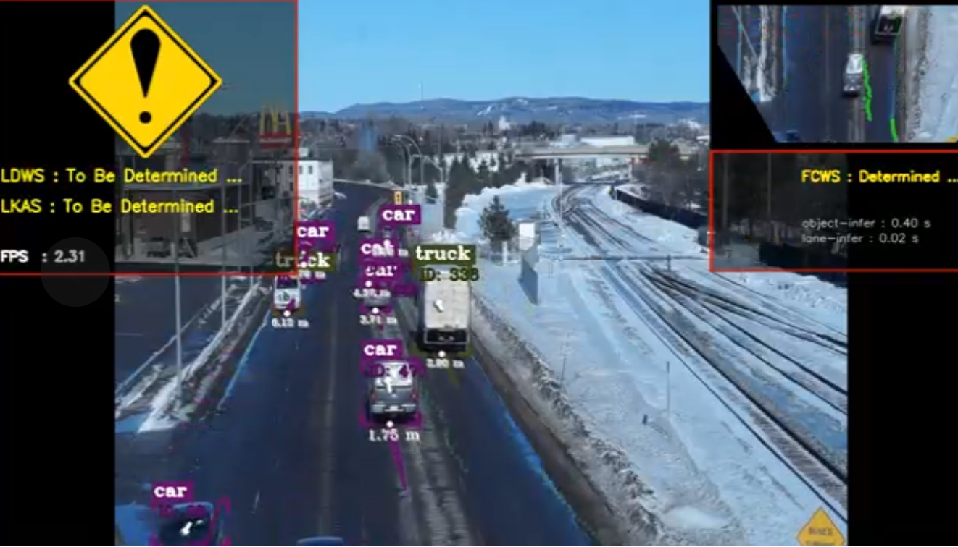
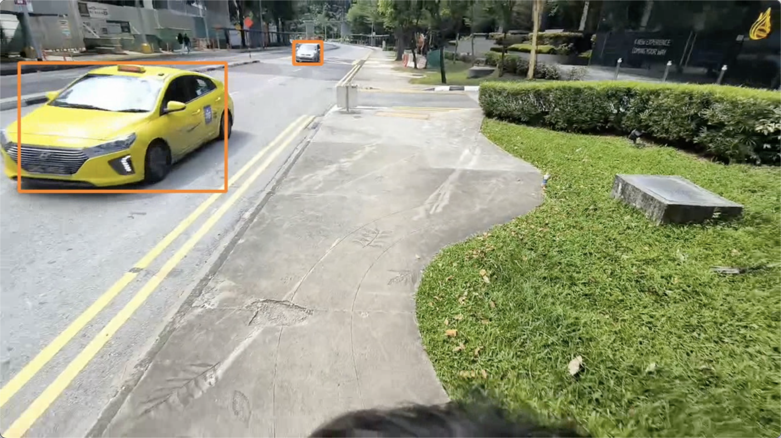
2.3.2 Tracking
Detection and Initialization:
Utilized YOLOv8 for object detections, providing bounding boxes and class probabilities. BoT-SORT initializes these detections with unique IDs for tracking.
Position Prediction and Data Association:
Used a Kalman filter for position prediction. Employed the Hungarian algorithm, combining appearance features from a CNN and motion prediction for accurate data association.
Handling Occlusions and Reidentification:
Managed occlusions with predicted positions and reidentified objects when they reappeared, ensuring continuous and accurate tracking.
Evaluation:
Evaluated tracking performance using Multiple Object Tracking Accuracy (MOTA) and Multiple Object Tracking Precision (MOTP).

Slide 21
2.3.3 Segmentation
Mask Coordinate Processing in HOLOH
Label Format: Includes bounding box coordinates and mask coordinates for each object.
Encoding Masks: Masks are rasterized into binary format for neural network processing.
Feature Extraction: Masks are combined with features from the network's backbone and neck.
Loss Calculation: Uses binary cross-entropy, IoU loss, and dice loss.
YOLOv8 Training Process
Data Preparation: Dataset with images and annotations; data augmentation applied.
Initialization: Weights initialized from pre-trained models or randomly.
Forward Pass: Input image processed through the network to extract features and make predictions.
Loss Computation: Combines object detection loss (localization, confidence, class probability) and segmentation loss.
Backward Pass: Gradients computed and parameters updated via optimization algorithms.
Training Loop: Multiple epochs with validation to monitor performance.
Outputs of YOLOv8
Bounding Boxes: Coordinates and confidence scores for detected objects.
Class Probabilities: Likelihood of each object belonging to various classes.
Segmentation Masks: Binary masks indicating object pixels.
Confidence Scores: Certainty of the predictions.

Slide 22
2.3.3.1 Drivable Segmentation
Methodology
YOLOv8 achieves drivable segmentation through its network architecture, which includes a backbone for feature extraction, a neck for multi-scale feature processing, and a specialized segmentation head. The segmentation head processes these features to predict pixel-wise segmentation masks, using a loss function that combines binary cross-entropy loss, IoU loss, and dice loss to ensure high accuracy.
During training, data augmentation techniques increase diversity, and the model iteratively optimizes its parameters. The extracted features are fed into the segmentation head, which outputs the predicted segmentation masks. Post-processing steps such as thresholding and morphological operations refine the masks, resulting in binary masks that indicate drivable areas.

Slide 23
2.3.3.1 Drivable Segmentation
Example Results
Ex.No | epochs | MAP50(B) | MAP50(M) | MAP50-95(B) | MAP50-95(M) | Precision(B) | Precision(M) | Recall(B) | Recall(M) | Train/Seg Loss | Val/ Seg Loss
Zero-shot | - | 0.24377 | 0.19964 | 0.08043 | 0.053 | 0.27541 | 0.26277 | 0.0356 | 0.28942 | 4.3118 | 4.1239
Freeze 22 | 1 | 0.3683 | 0.2835 | 0.13298 | 3E-05 | 0.08156 | 0.34091 | 0.45506 | 0.36431 | 3.5414 | 3.5693
 | 40 | 0.06243 | 0.00218 | 0.02824 | 0.00066 | 0.24854 | 0.13434 | 0.09381 | 0.00851 | 2.7594 | 2.6466
Freeze 10 | 1 | 0.23664 | 0.18766 | 0.07031 | 0.03428 | 0.25263 | 0.23347 | 0.35462 | 0.23943 | 4.45532 | 4.2223
 | 40 | 0.08068 | 0.85529 | 0.61002 | 0.56037 | 0.80433 | 0.80406 | 0.78299 | 0.77227 | 1.6967 | 1.6019

Slide 24
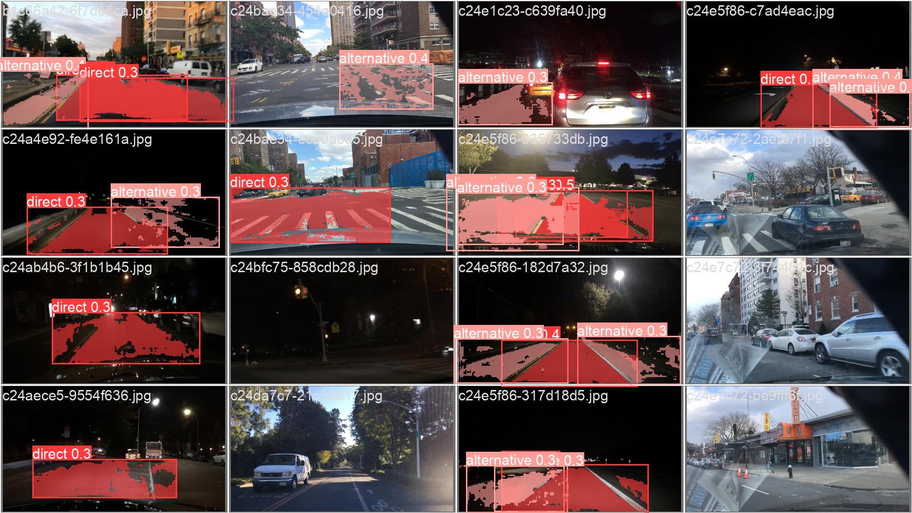
2.3.3.1 Drivable Segmentation

Slide 25
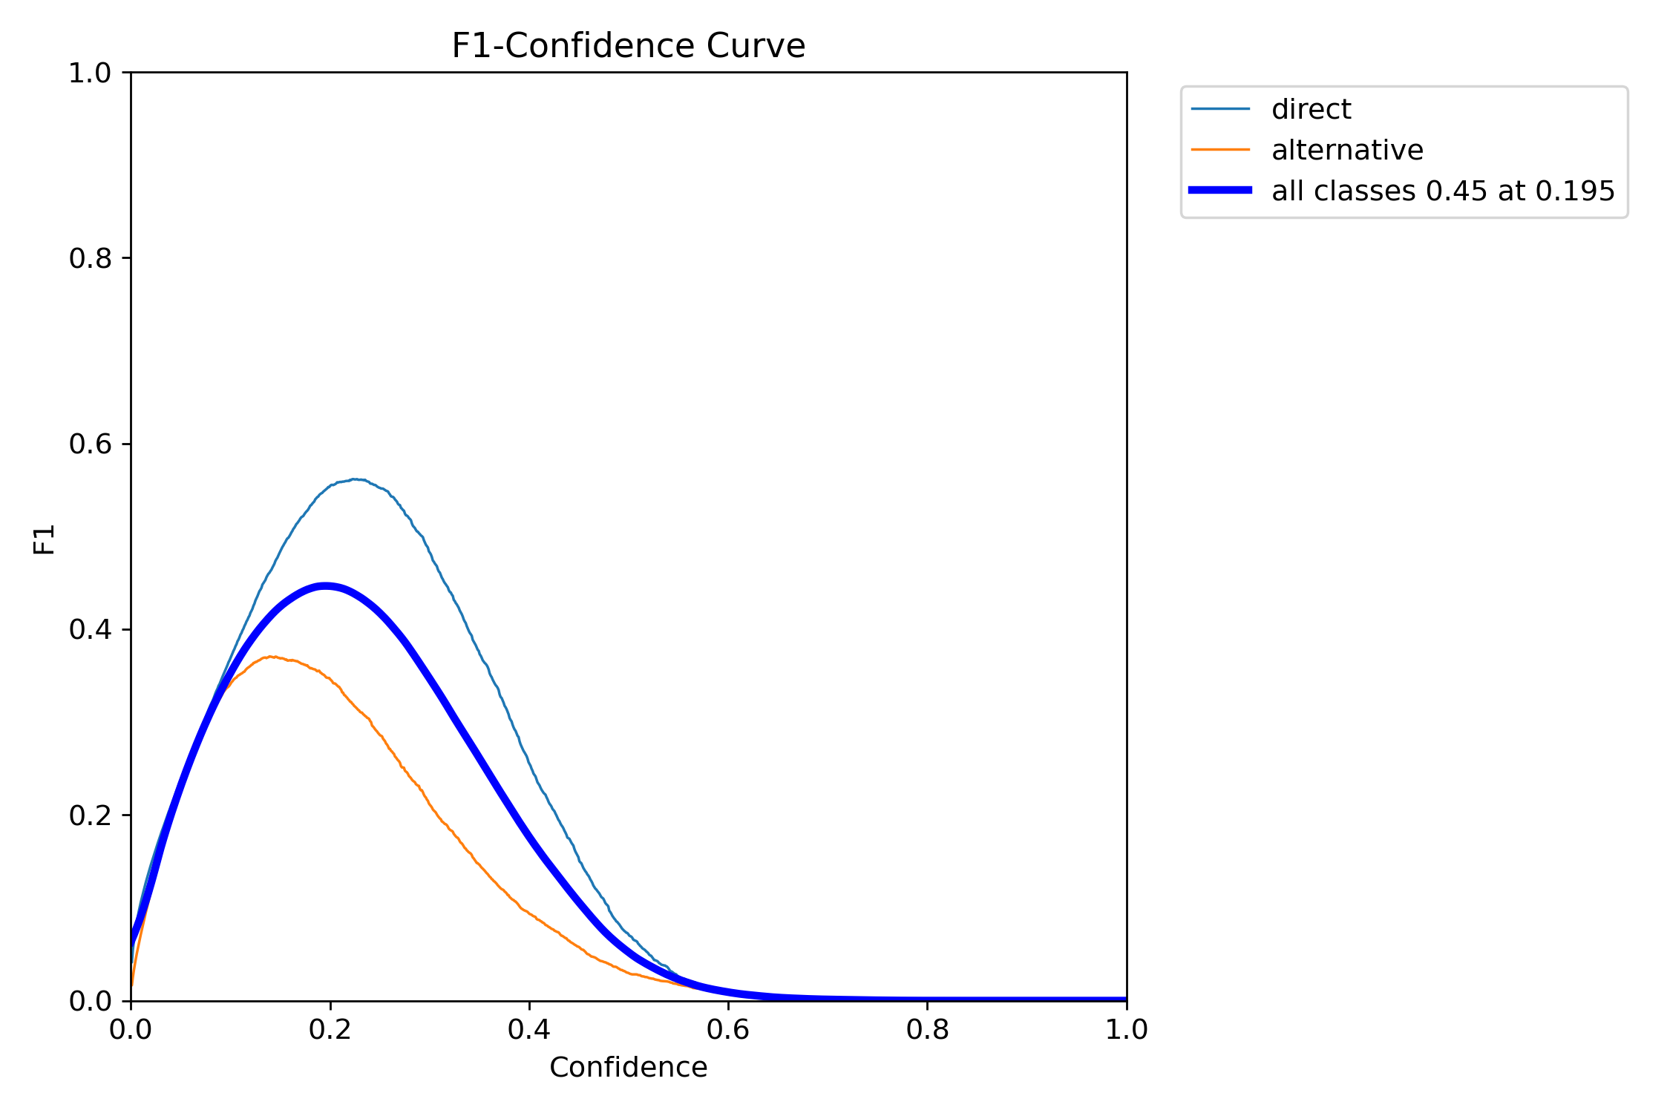
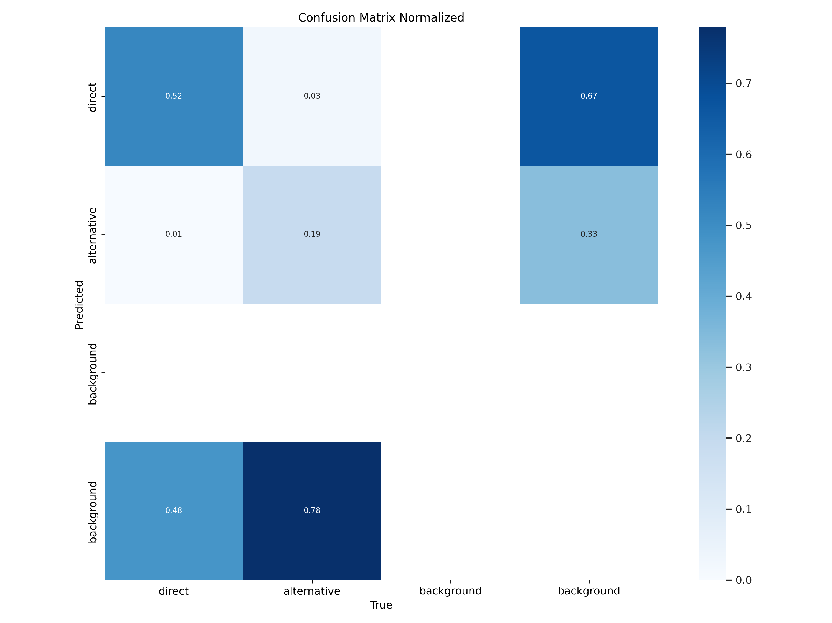
2.3.3.1 Drivable Segmentation

Slide 26
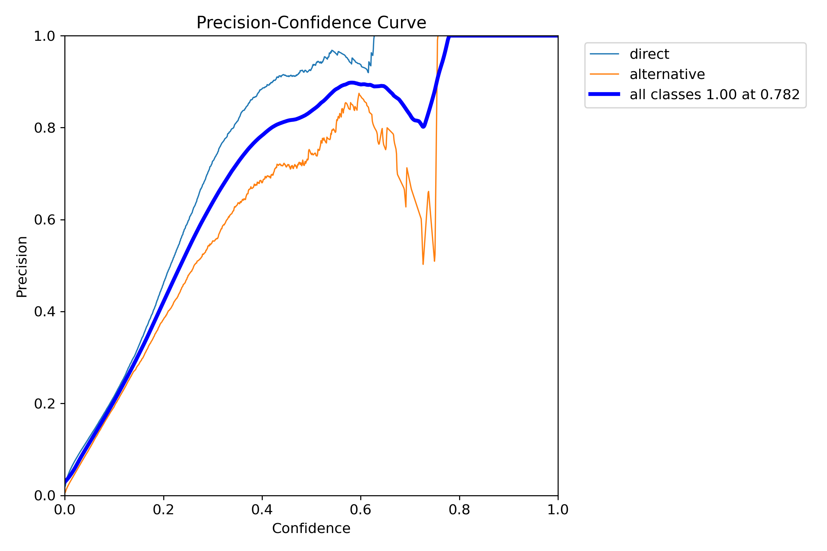
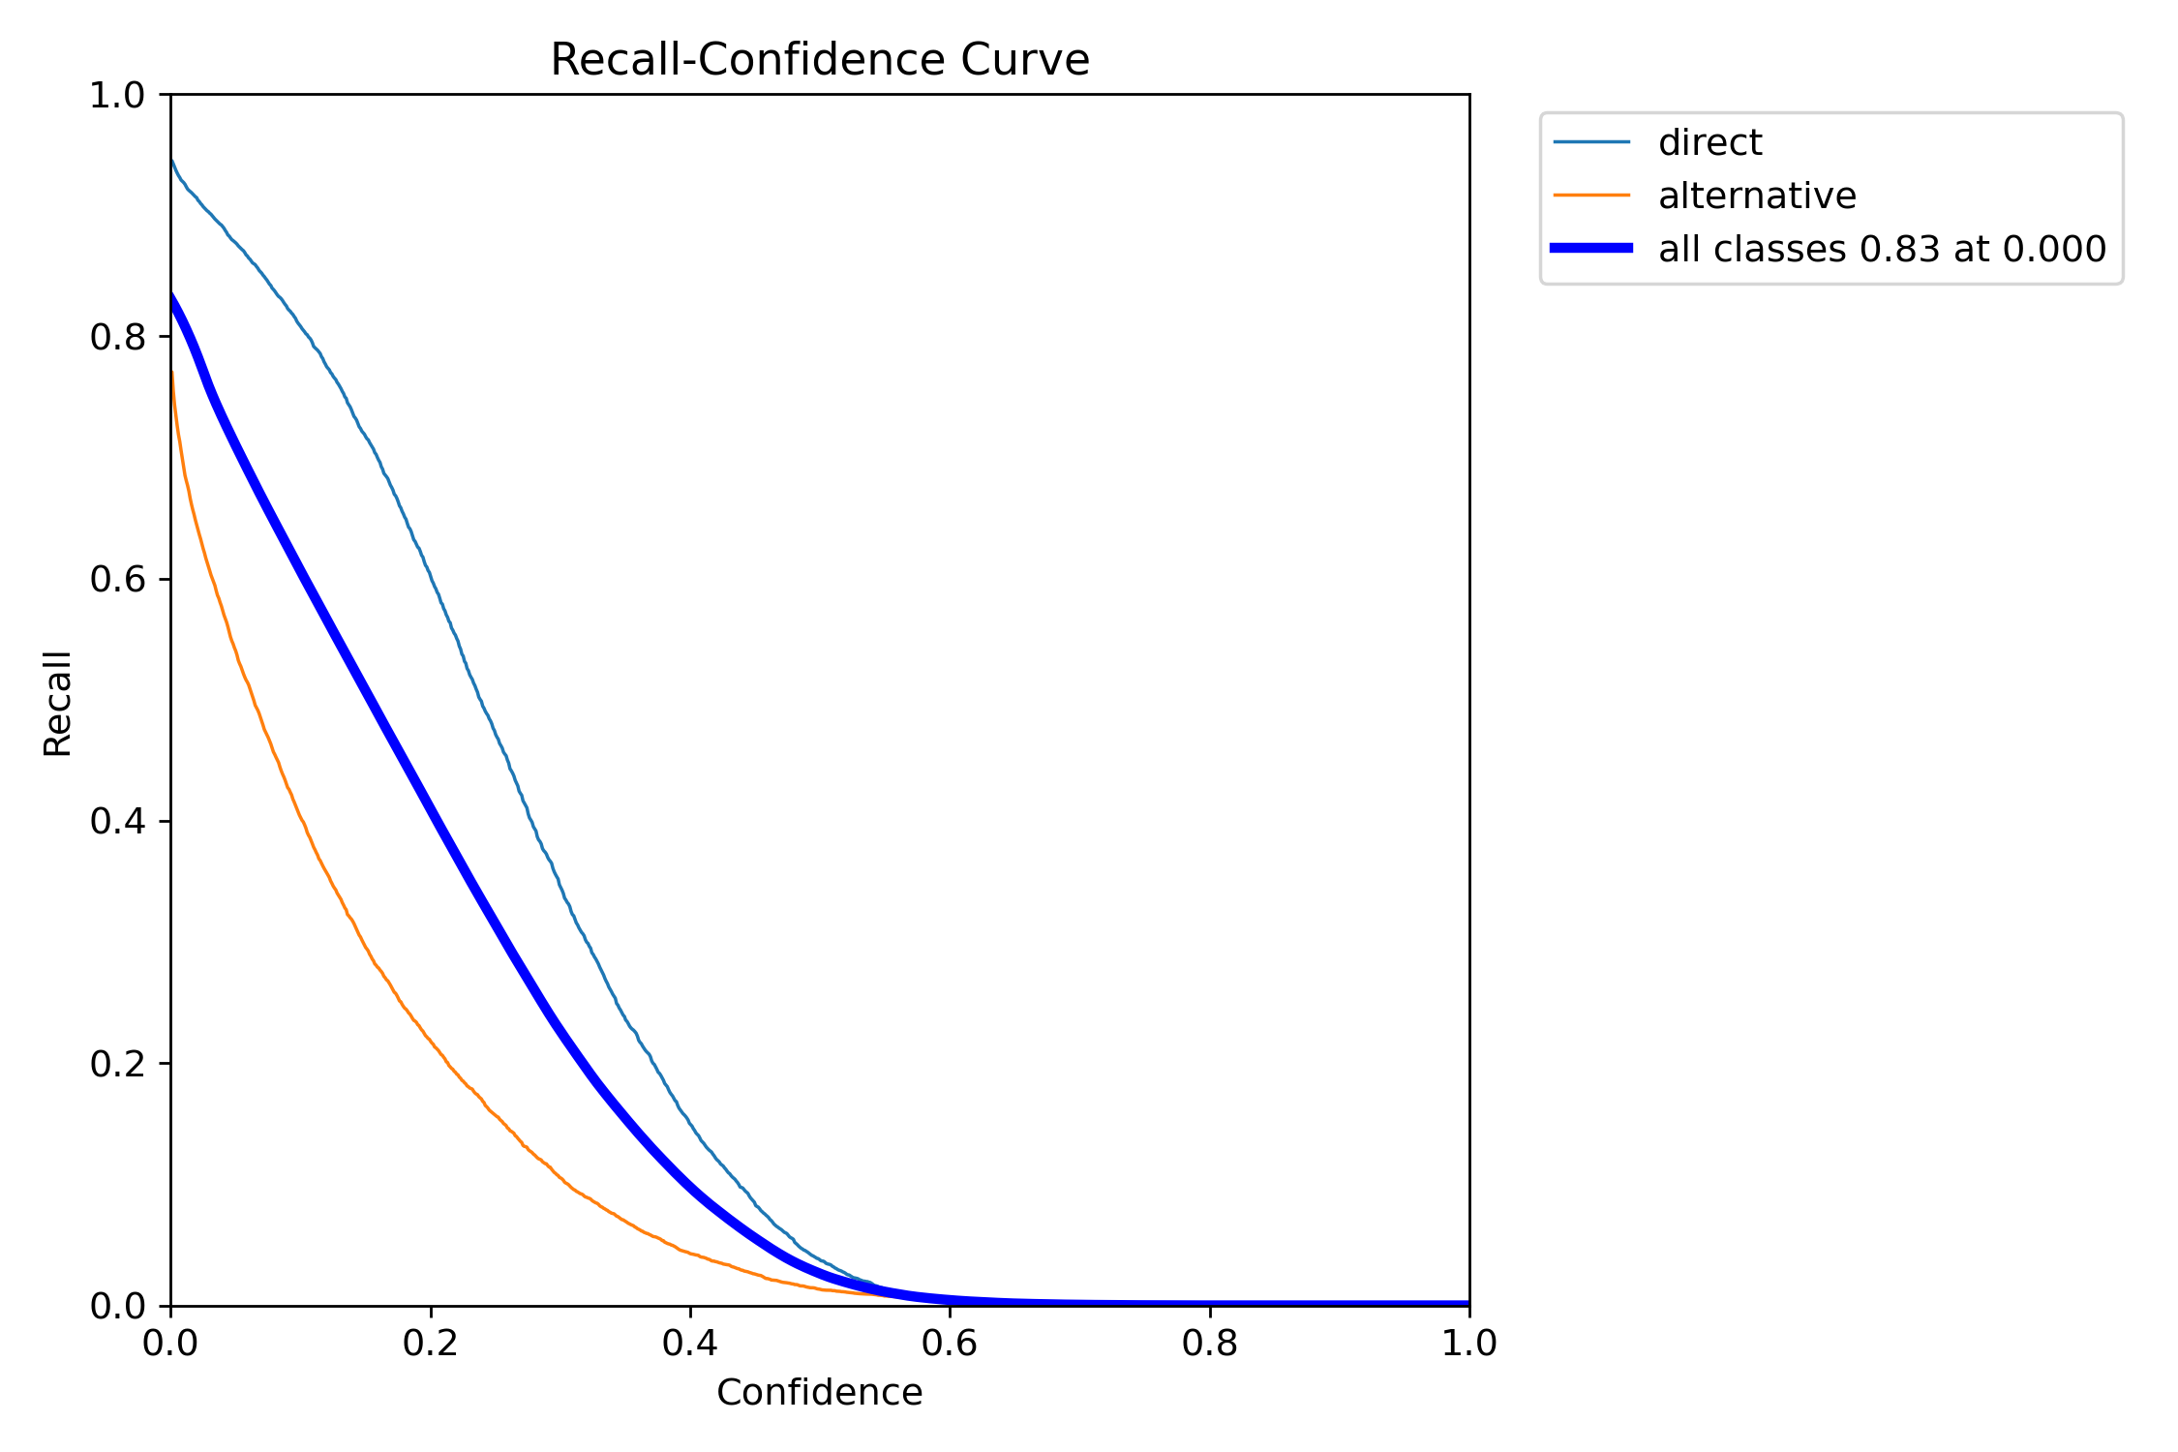
2.3.3.1 Drivable Segmentation

Slide 27
2.3.3.2 Lane Segmentation
Experiments design:
Val: zero-shot
Freeze 22 to only obtain output layer to train
1 epoch
40 epoch
Freeze 10 to only obtain head section to train
1 epoch
40 epoch
Notes:
### Experiment Design Explanation
#### Val-zero shot:
- **Objective**: To evaluate the model's performance on the validation set without any fine-tuning or training on the specific task of lane segmentation.
- **Purpose**: This serves as a baseline to understand how well the pre-trained model performs out-of-the-box on lane segmentation tasks.
#### Freeze 22 to only obtain output layer to train:
- **Objective**: To fine-tune the model by training only the output layer while keeping the first 22 layers frozen.
- **Details**:
- **1 Epoch**: Train the output layer for one epoch to observe the initial impact of fine-tuning on the model's performance.
- **40 Epochs**: Train the output layer for 40 epochs to evaluate the improvement over an extended period of training.
- **Purpose**: This approach helps in understanding how well the output layer alone can adapt to the lane segmentation task with minimal changes to the rest of the network.
#### Freeze 10 to only obtain head section to train:
- **Objective**: To fine-tune the model by training the head section (the last few layers) while keeping the first 10 layers frozen.
- **Details**:
- **1 Epoch**: Train the head section for one epoch to see the immediate effect of fine-tuning these layers.
- **40 Epochs**: Train the head section for 40 epochs to assess the performance improvement with more extensive training.
- **Purpose**: This method aims to determine how training a larger portion of the model (compared to just the output layer) impacts the lane segmentation performance.

Slide 28
2.3.3.2 Lane Segmentation
Experiment Result
Ex.No | epochs | MAP50(B) | MAP50(M) | MAP50-95(B) | MAP50-95(M) | Precision(B) | Precision(M) | Recall(B) | Recall(M) | Train/Seg Loss | Val/ Seg Loss
Zero-shot | - | 0.000428 |  | 0.000109 |  | 0.000789 |  | 0.0356 |  | - | -
Freeze 22 | 1 | 0.02977 | 0.00012 | 0.01209 | 3E-05 | 0.21166 | 0.00022 | 0.05215 | 0.00639 | 3.2894 | 2.8795
 | 40 | 0.06243 | 0.00218 | 0.02824 | 0.00066 | 0.24854 | 0.13434 | 0.09381 | 0.00851 | 2.7594 | 2.6466
Freeze 10 | 1 | 0.11062 | 0.00815 | 0.05982 | 0.00188 | 0.24117 | 0.02579 | 0.13441 | 0.02313 | 2.6511 | 2.4922
 | 40 | 0.24188 | 0.0414 | 0.15668 | 0.01051 | 0.46759 | 0.23857 | 0.24123 | 0.08159 | 2.2391 | 2.1855
Notes:
Key Observations
1. Zero-shot Performance:
• The zero-shot experiment serves as a baseline, showing very low MAP50 and MAP50-95 for bounding boxes and masks. This indicates that the pre-trained model performs poorly on the lane segmentation task without any fine-tuning.
2. Freeze 22:
• 1 Epoch: There is a noticeable improvement over the zero-shot baseline in MAP50 (B) and Precision (B). However, the MAP50-95 (B) remains low, indicating limited improvement in overall precision.
• 40 Epochs: Training for 40 epochs further improves the performance. The MAP50 (B) and MAP50 (M) increase significantly, and precision metrics also show a positive trend. The segmentation losses (both train and validation) decrease, indicating better learning and generalization.
3. Freeze 10:
• 1 Epoch: Freezing only the first 10 layers and training the head section results in a substantial boost in performance even after just one epoch. MAP50 (B), MAP50 (M), and precision metrics are much higher compared to the Freeze 22 (1 Epoch) experiment.
• 40 Epochs: Extending the training to 40 epochs leads to the best performance across all metrics. MAP50 (B) and MAP50 (M) reach their highest values, along with significant improvements in MAP50-95, precision, and recall. The reduction in both train and validation segmentation losses indicates robust learning.
Detailed Discussion
• Zero-shot Baseline: The zero-shot performance highlights the necessity of fine-tuning for specific tasks like lane segmentation. The initial metrics show that the pre-trained model is not effective without task-specific training.
• Freeze 22: This approach shows that minimal fine-tuning (freezing the first 22 layers) results in moderate improvements. Training the output layer for 1 epoch yields some gains, but 40 epochs are necessary for significant performance improvements. The segmentation losses decrease with extended training, indicating better model adaptation.
• Freeze 10: Allowing more layers to be fine-tuned (by freezing fewer layers) leads to the most substantial improvements. After 1 epoch, the metrics show a significant boost, and 40 epochs of training provide the highest performance across all metrics. This strategy clearly benefits from the additional trainable parameters, resulting in better generalization and accuracy.
Conclusion
Training the HOLOH model by freezing only the first 10 layers and allowing the head section to train yields the best performance for lane segmentation tasks. This approach balances the need for retaining pre-trained features while adapting the model to the specific requirements of lane segmentation. Future efforts should focus on this strategy to achieve optimal results.

Slide 29
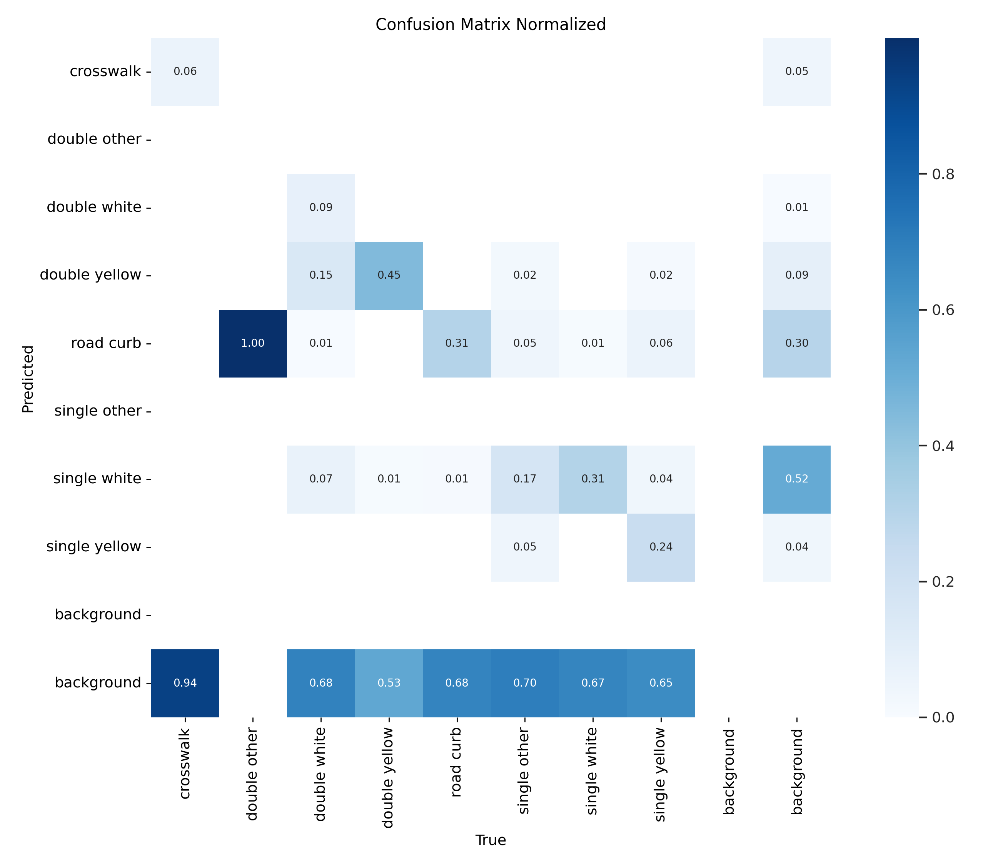
2.3.3.2 Lane Segmentation
Notes:
4. Confusion Matrix
• Display: This matrix provides a detailed view of the classification accuracy for each class by showing the true positive, false positive, and false negative rates.
• Discussion:
• The “road curb” class is predicted with high accuracy, showing minimal confusion with other classes.
• Other classes, such as “double white” and “single white,” show significant misclassification rates, highlighting challenges in distinguishing between these categories.

Slide 30
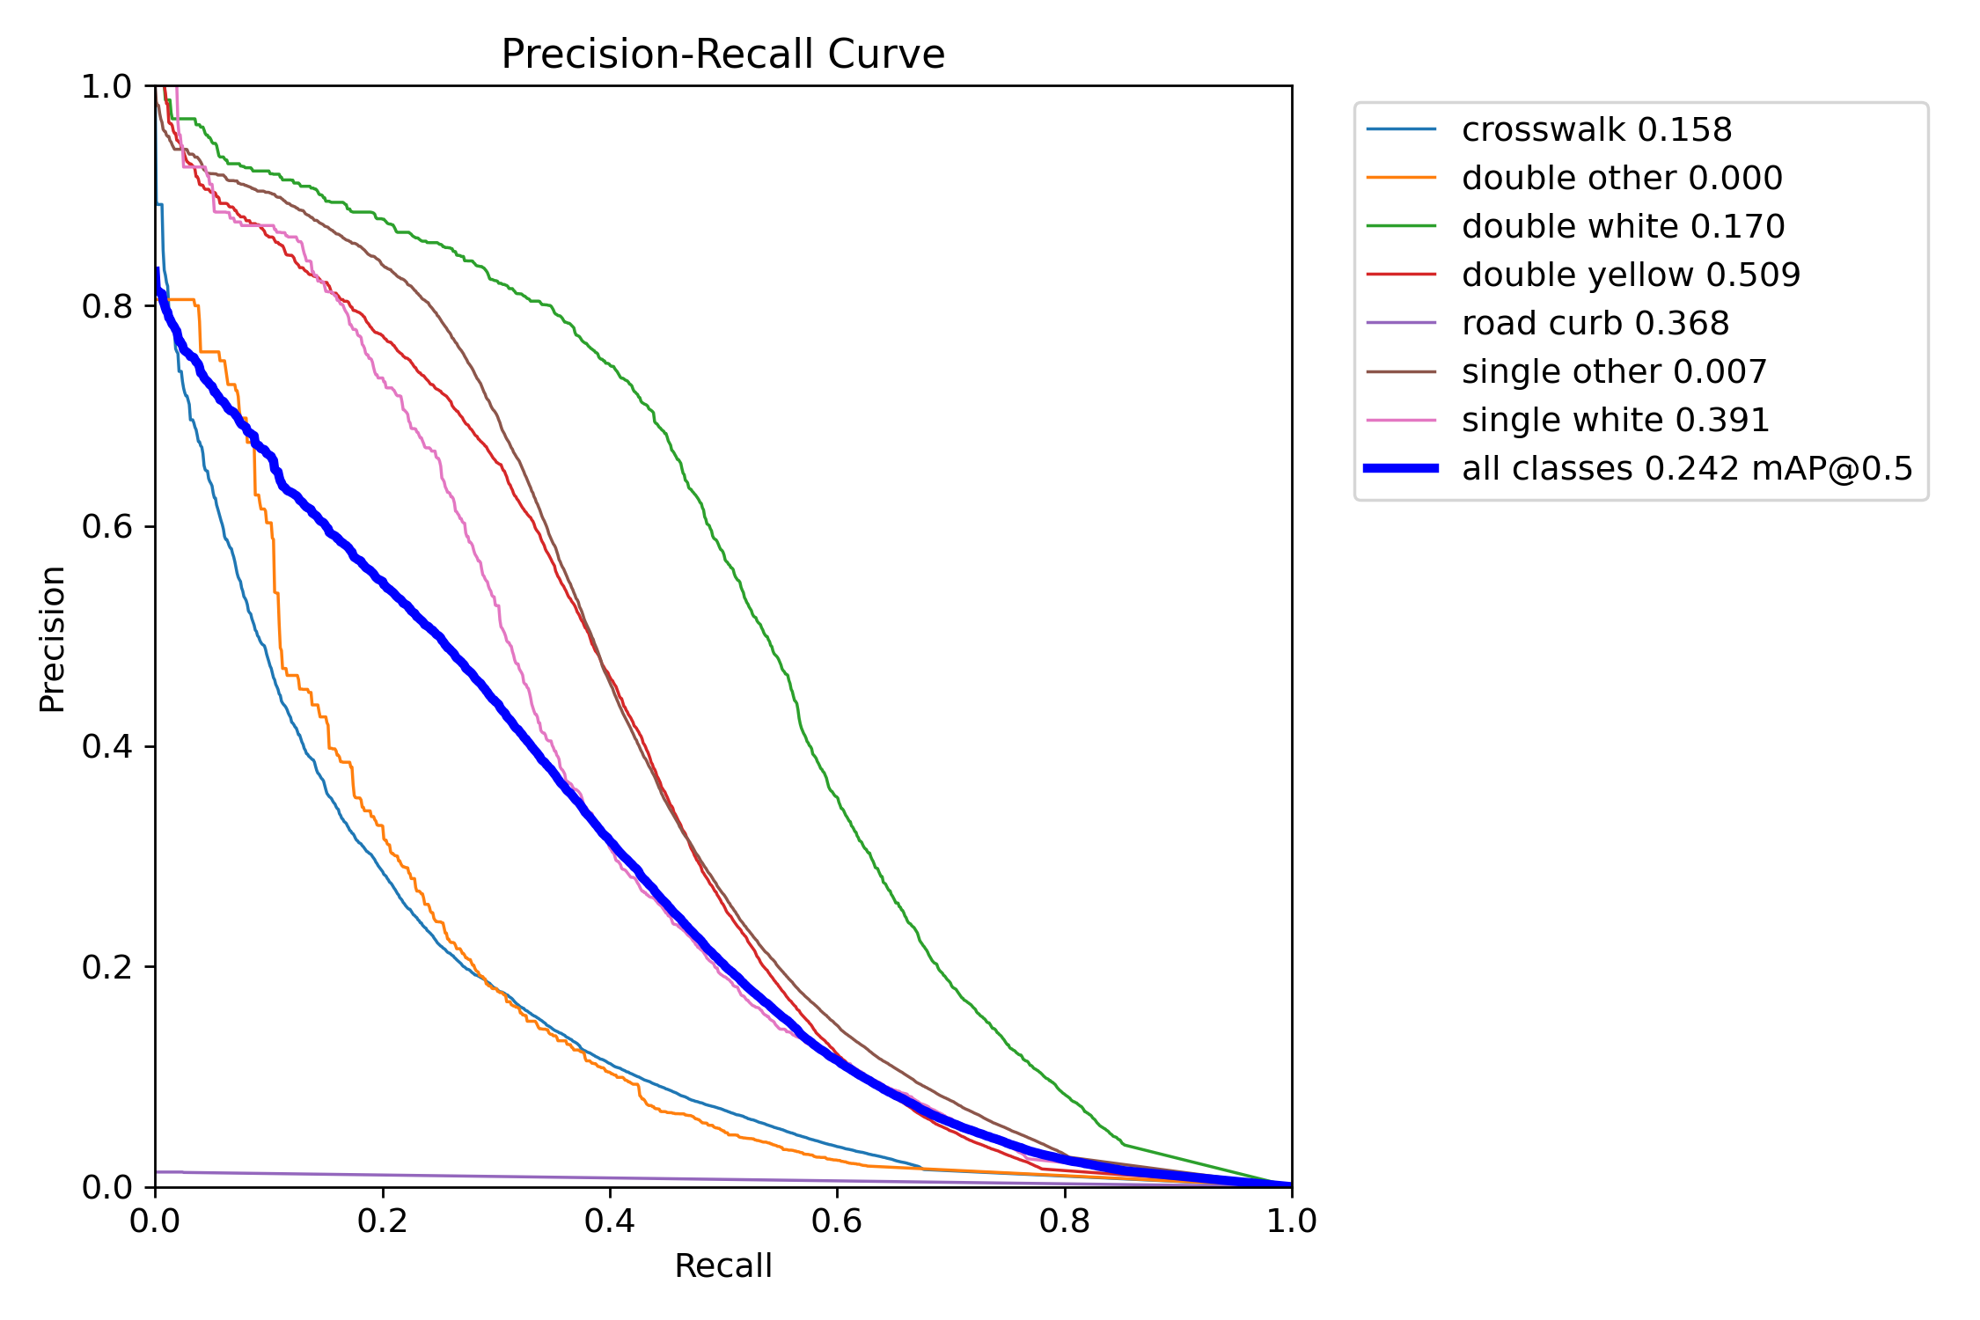
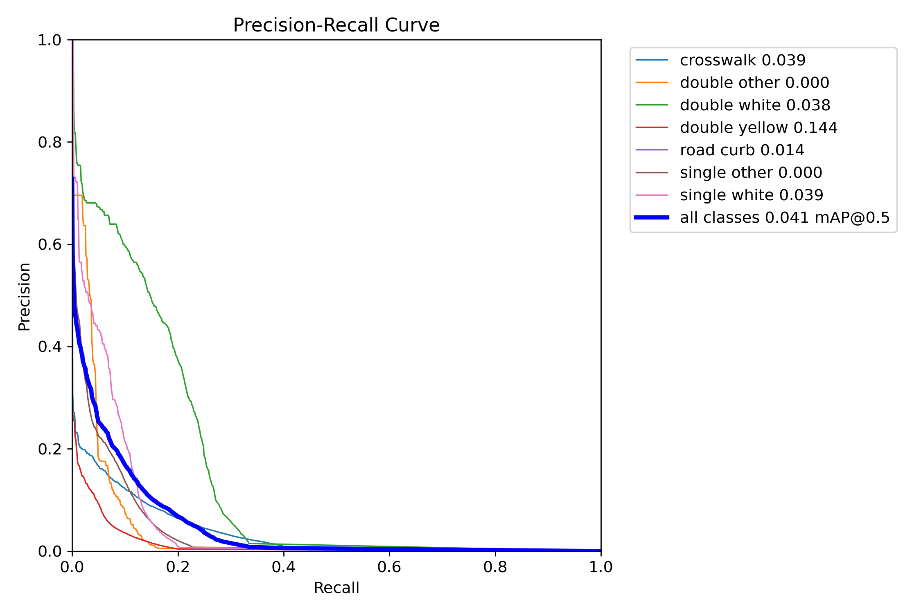
2.3.3.2 Lane Segmentation
Box
Mask
Notes:
### Discussion of Precision-Recall Curves
#### 1. **Box Precision-Recall Curve**
- **Overview**: This curve represents the precision-recall relationship for the bounding box predictions across different classes.
- **Key Observations**:
- **All Classes**: The mean average precision at IoU threshold 0.5 (mAP@0.5) for all classes is 0.066. This suggests that the bounding box predictions achieve a modest balance between precision and recall overall.
- **Individual Classes**:
- **Double Yellow**: This class achieves the highest individual precision with a value of 0.192, indicating relatively accurate predictions when a bounding box is identified as a double yellow line.
- **Road Curb**: With a precision of 0.072, this class also shows reasonably good performance, but there's room for improvement.
- **Crosswalk, Double White, Single Other, Double Other, Single White**: These classes exhibit lower precision, with precision values significantly lower than double yellow and road curb. The poor performance here suggests that the model struggles to distinguish these classes accurately.
- **Implications**: The bounding box predictions for certain classes (e.g., double yellow and road curb) are more reliable, but the overall performance indicates that the model may require further training or fine-tuning to improve precision and recall across all classes.
#### 2. **Mask Precision-Recall Curve**
- **Overview**: This curve illustrates the precision-recall relationship for the segmentation mask predictions across different classes.
- **Key Observations**:
- **All Classes**: The mean average precision at IoU threshold 0.5 (mAP@0.5) for all classes is 0.002, which is notably lower than the bounding box mAP@0.5. This indicates that segmentation tasks are significantly more challenging for the model.
- **Individual Classes**:
- **Double Yellow**: With a precision of 0.006, this class again performs relatively better than others but still shows low overall precision.
- **Road Curb**: This class has a precision of 0.001, indicating difficulty in accurately predicting segmentation masks for road curbs.
- **Crosswalk, Double White, Single Other, Double Other, Single White**: These classes exhibit very low precision, similar to the bounding box results, reflecting challenges in accurate segmentation.
- **Implications**: The low precision and recall values across all classes indicate that the segmentation task is challenging for the model. The results suggest that further improvements, such as more extensive training, better data augmentation, or model architecture enhancements, are necessary to boost performance in segmentation tasks.
### Summary
The precision-recall curves for both bounding boxes and segmentation masks reveal that while the model shows some ability to make accurate predictions for certain classes, the overall performance, especially in segmentation, requires significant improvement. Future efforts should focus on refining the model and possibly exploring additional data or advanced techniques to enhance its ability to handle both bounding box and segmentation tasks effectively.

Slide 31
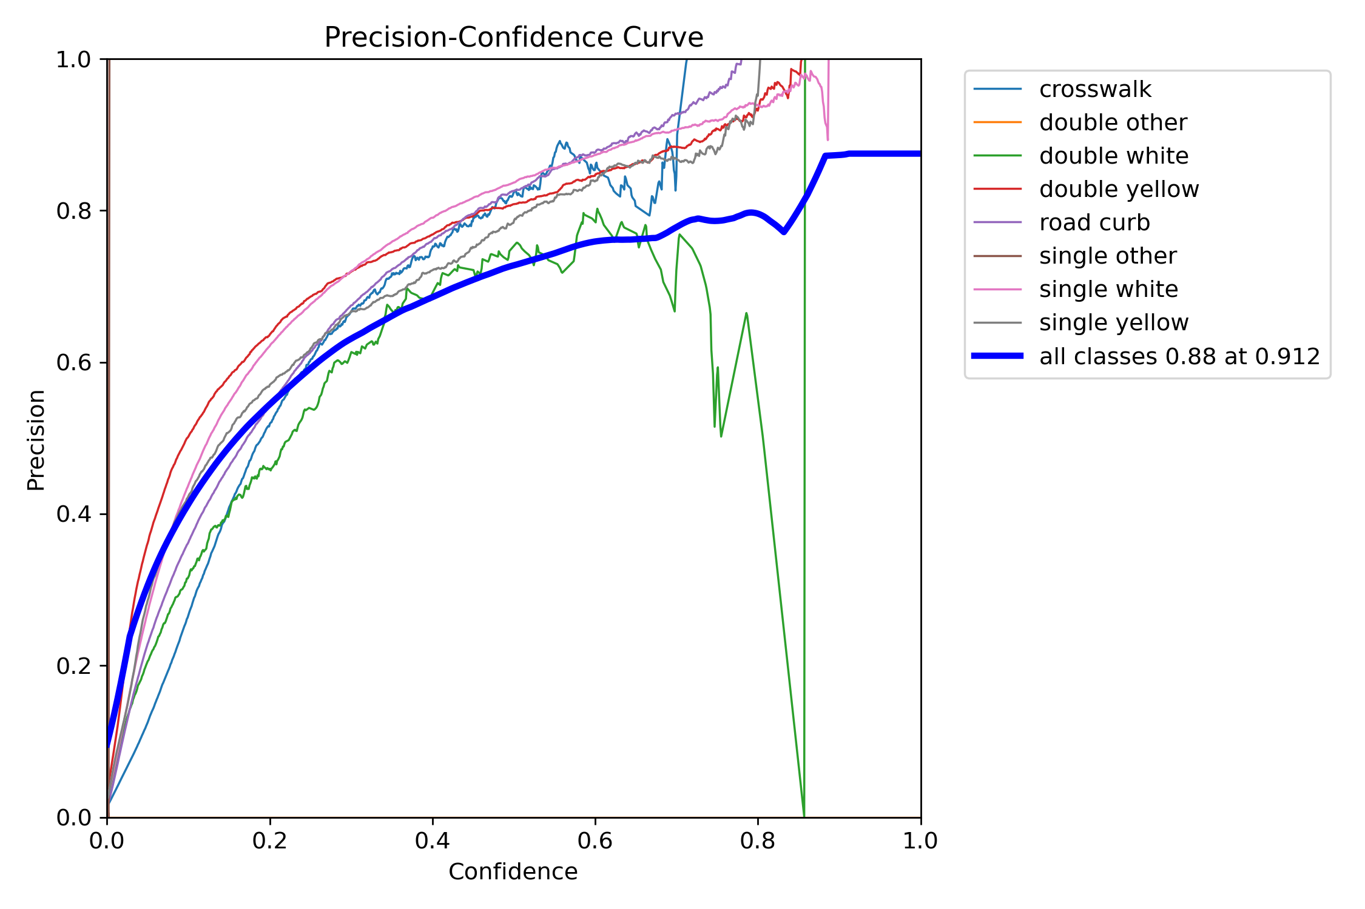
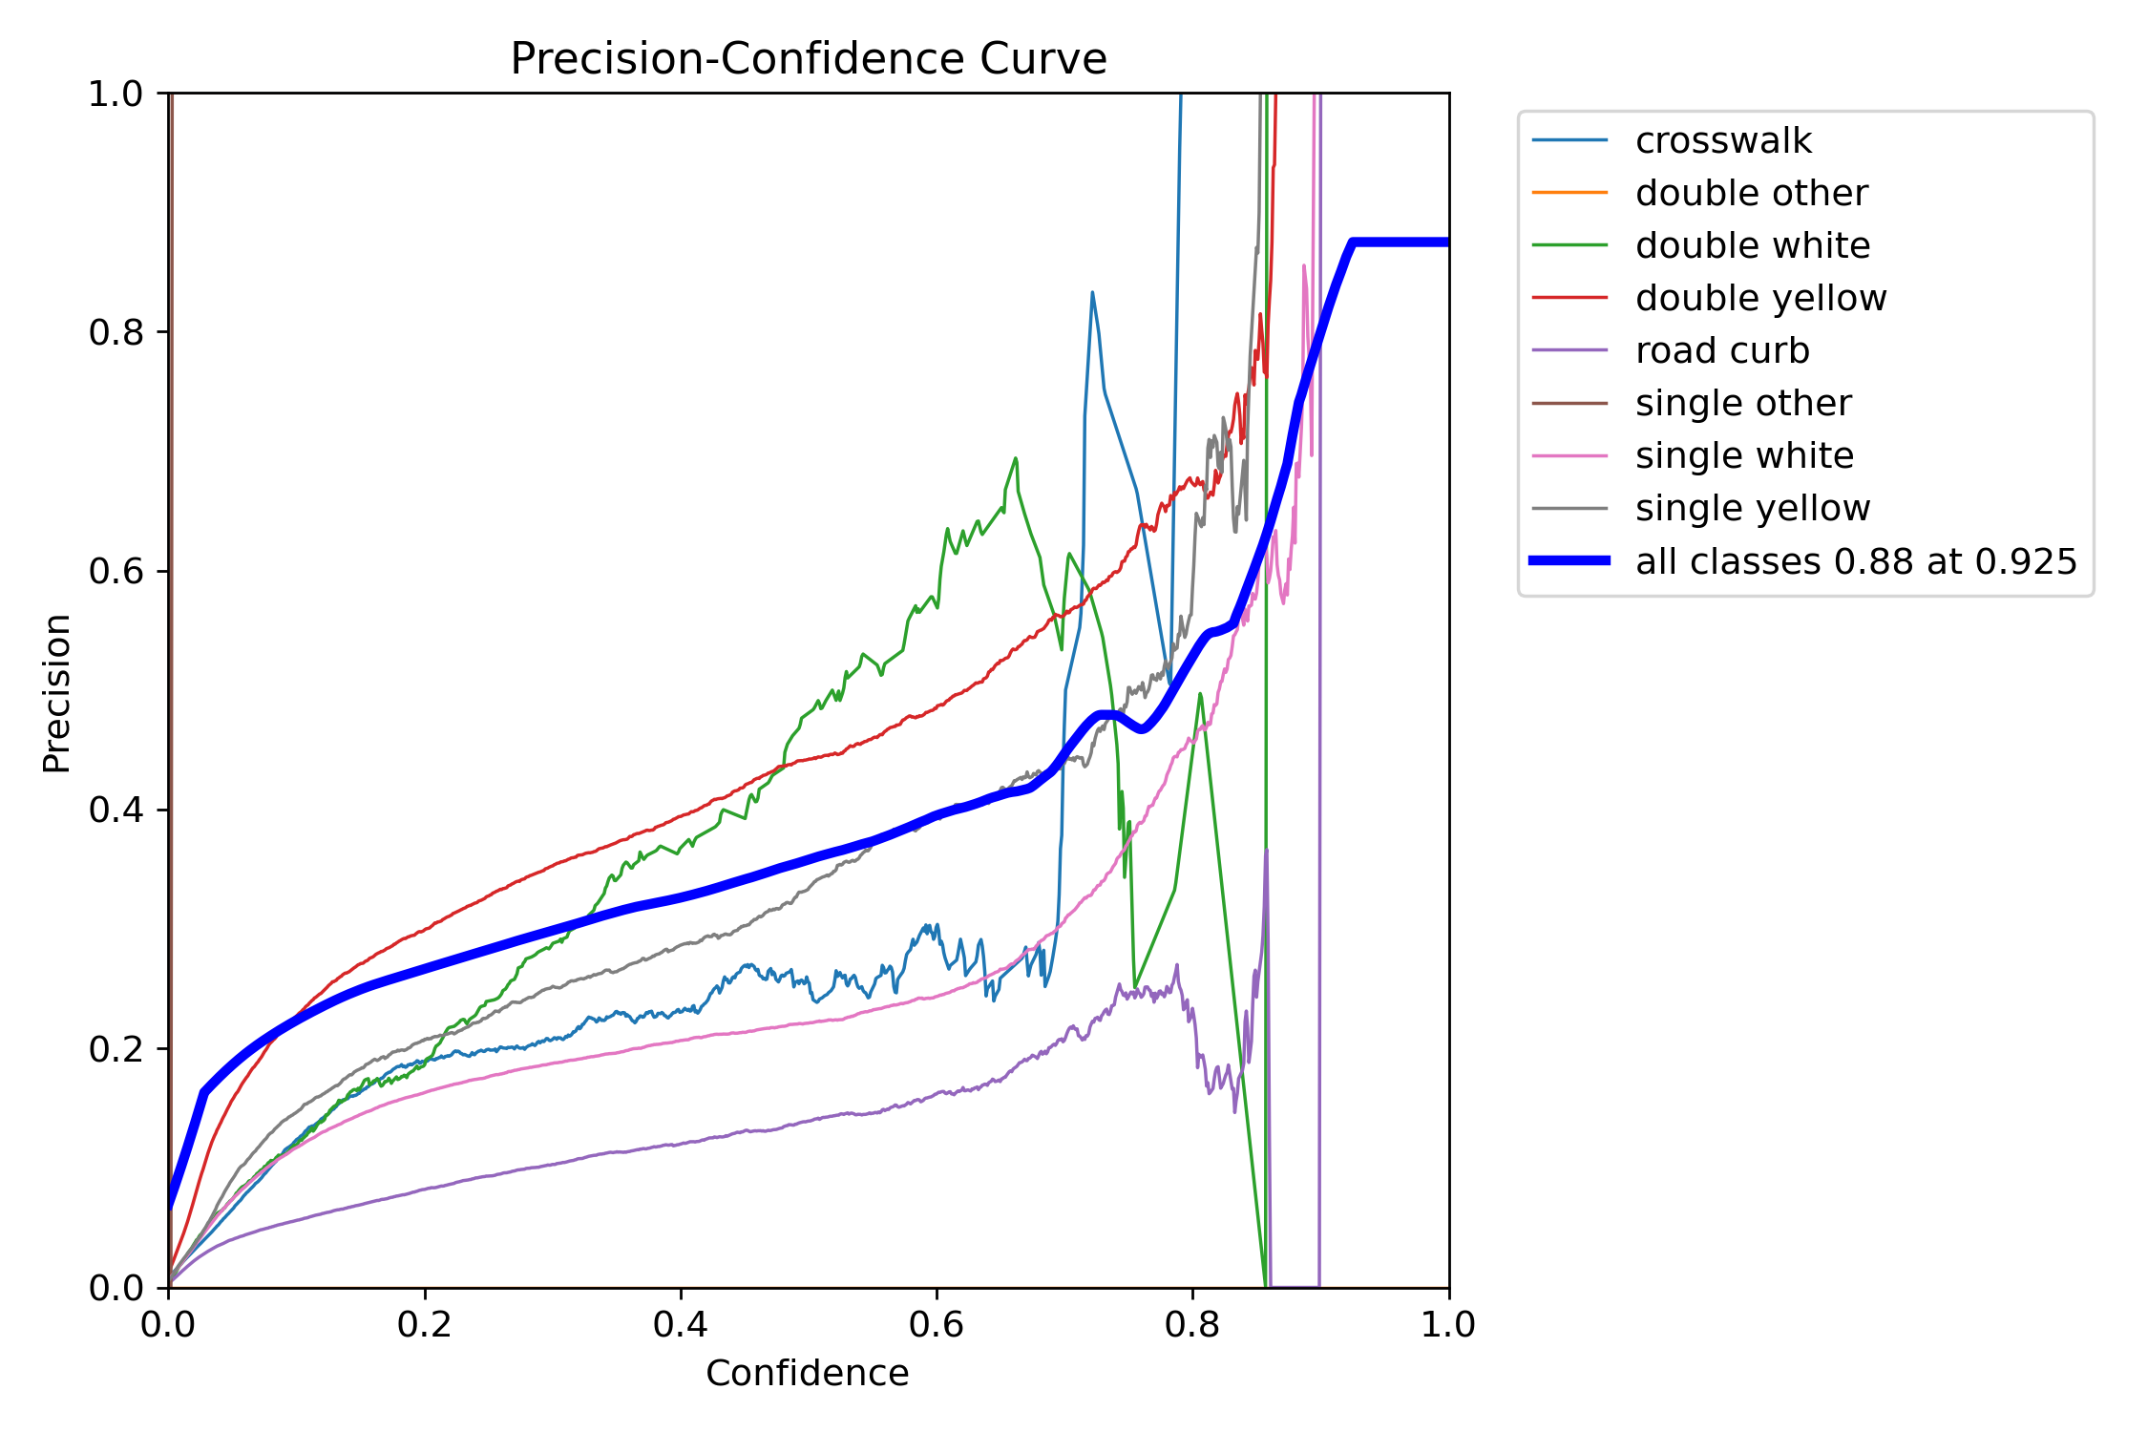
2.3.3.2 Lane Segmentation
Box
Mask
Notes:
### Discussion of Precision-Confidence Curves
#### 1. **Box Precision-Confidence Curve**
- **Overview**: This curve represents the precision of the bounding box predictions across different confidence thresholds for various classes.
- **Key Observations**:
- **All Classes**: The average precision for all classes reaches 0.75 at a confidence level of 0.767. This indicates that at a higher confidence threshold, the bounding box predictions are fairly accurate.
- **Individual Classes**:
- **Double Yellow**: This class shows a high precision, peaking close to 0.9 at higher confidence levels. It signifies that when the model is confident about predicting a double yellow line, it is usually correct.
- **Single White and Single Yellow**: These classes also achieve high precision at higher confidence levels but exhibit more fluctuations, indicating variability in prediction confidence.
- **Crosswalk and Road Curb**: These classes show significant variability in precision, suggesting inconsistent predictions.
- **Implications**: The precision-confidence curve for bounding boxes suggests that while the model achieves high precision at higher confidence levels, there is variability among different classes. This indicates a need for further refinement, especially for classes with fluctuating precision.
#### 2. **Mask Precision-Confidence Curve**
- **Overview**: This curve illustrates the precision of the segmentation mask predictions across different confidence thresholds for various classes.
- **Key Observations**:
- **All Classes**: The average precision for all classes reaches 0.75 at a confidence level of 0.814. This indicates that the model achieves a good level of precision in its segmentation predictions at higher confidence levels.
- **Individual Classes**:
- **Double Yellow**: Similar to the bounding box precision, this class achieves high precision, reaching close to 0.9 at higher confidence levels. This consistency indicates reliable segmentation for double yellow lines.
- **Single White and Road Curb**: These classes show variability but achieve higher precision at confidence levels above 0.6.
- **Crosswalk and Single Yellow**: These classes exhibit lower and more variable precision, indicating challenges in consistent segmentation.
- **Implications**: The precision-confidence curve for segmentation masks suggests that the model can achieve high precision for certain classes at higher confidence levels. However, variability in precision across classes indicates the need for further training and fine-tuning to improve consistency and accuracy.
### Summary
The precision-confidence curves for both bounding boxes and segmentation masks reveal that the model can achieve high precision at higher confidence levels, particularly for certain classes like double yellow lines. However, there is variability in precision among different classes, indicating areas for improvement. Future work should focus on enhancing the model's ability to make consistent and accurate predictions across all classes, particularly those with lower precision and higher variability.

Slide 32
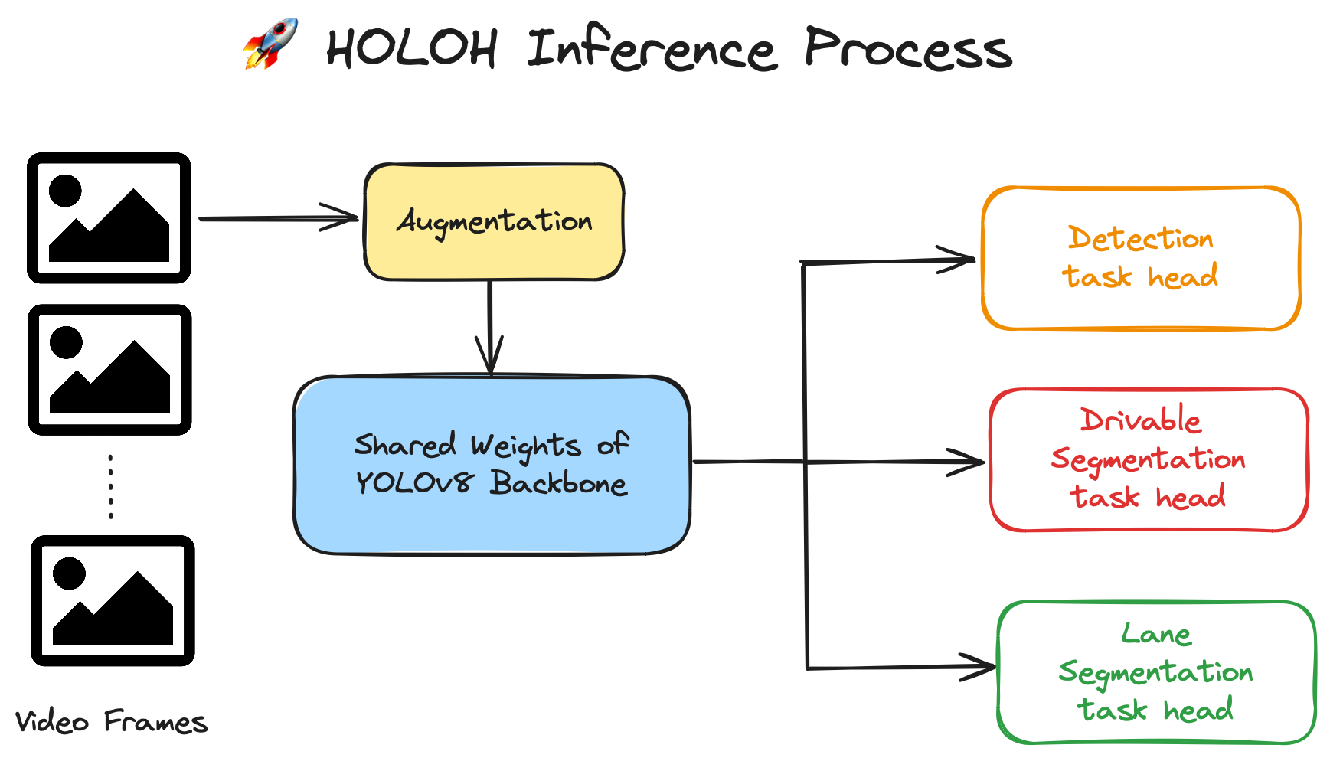
2.4.1 Inference Process

Slide 33
2.4.2 Test Time Augmentation
Test Time Augmentation improves model accuracy by applying transformations to input images during inference.
In our implementation, TTA involves:
Left-Right Flipping: Each image is horizontally flipped.
Multi-Resolution Processing: Images are processed at three different resolutions (e.g., 640, 832, and an intermediate size). The model generates predictions for each augmented version and merge them using Non-Maximum Suppression (NMS) for the final output.
Enabling TTA increases inference time by 2-3 times due to larger image sizes (832 vs. Original 640 pixels) and additional processing steps. Despite the longer inference time, TTA significantly enhances prediction accuracy and robustness during real-world demo testing, so we still involve it and plan to optimize in the future.
w.o. TTA fps | w. TTA fps
0.0479 | 0.1149 (~2.3x slower)

Slide 34
2.4.3 Showcase

Slide 35
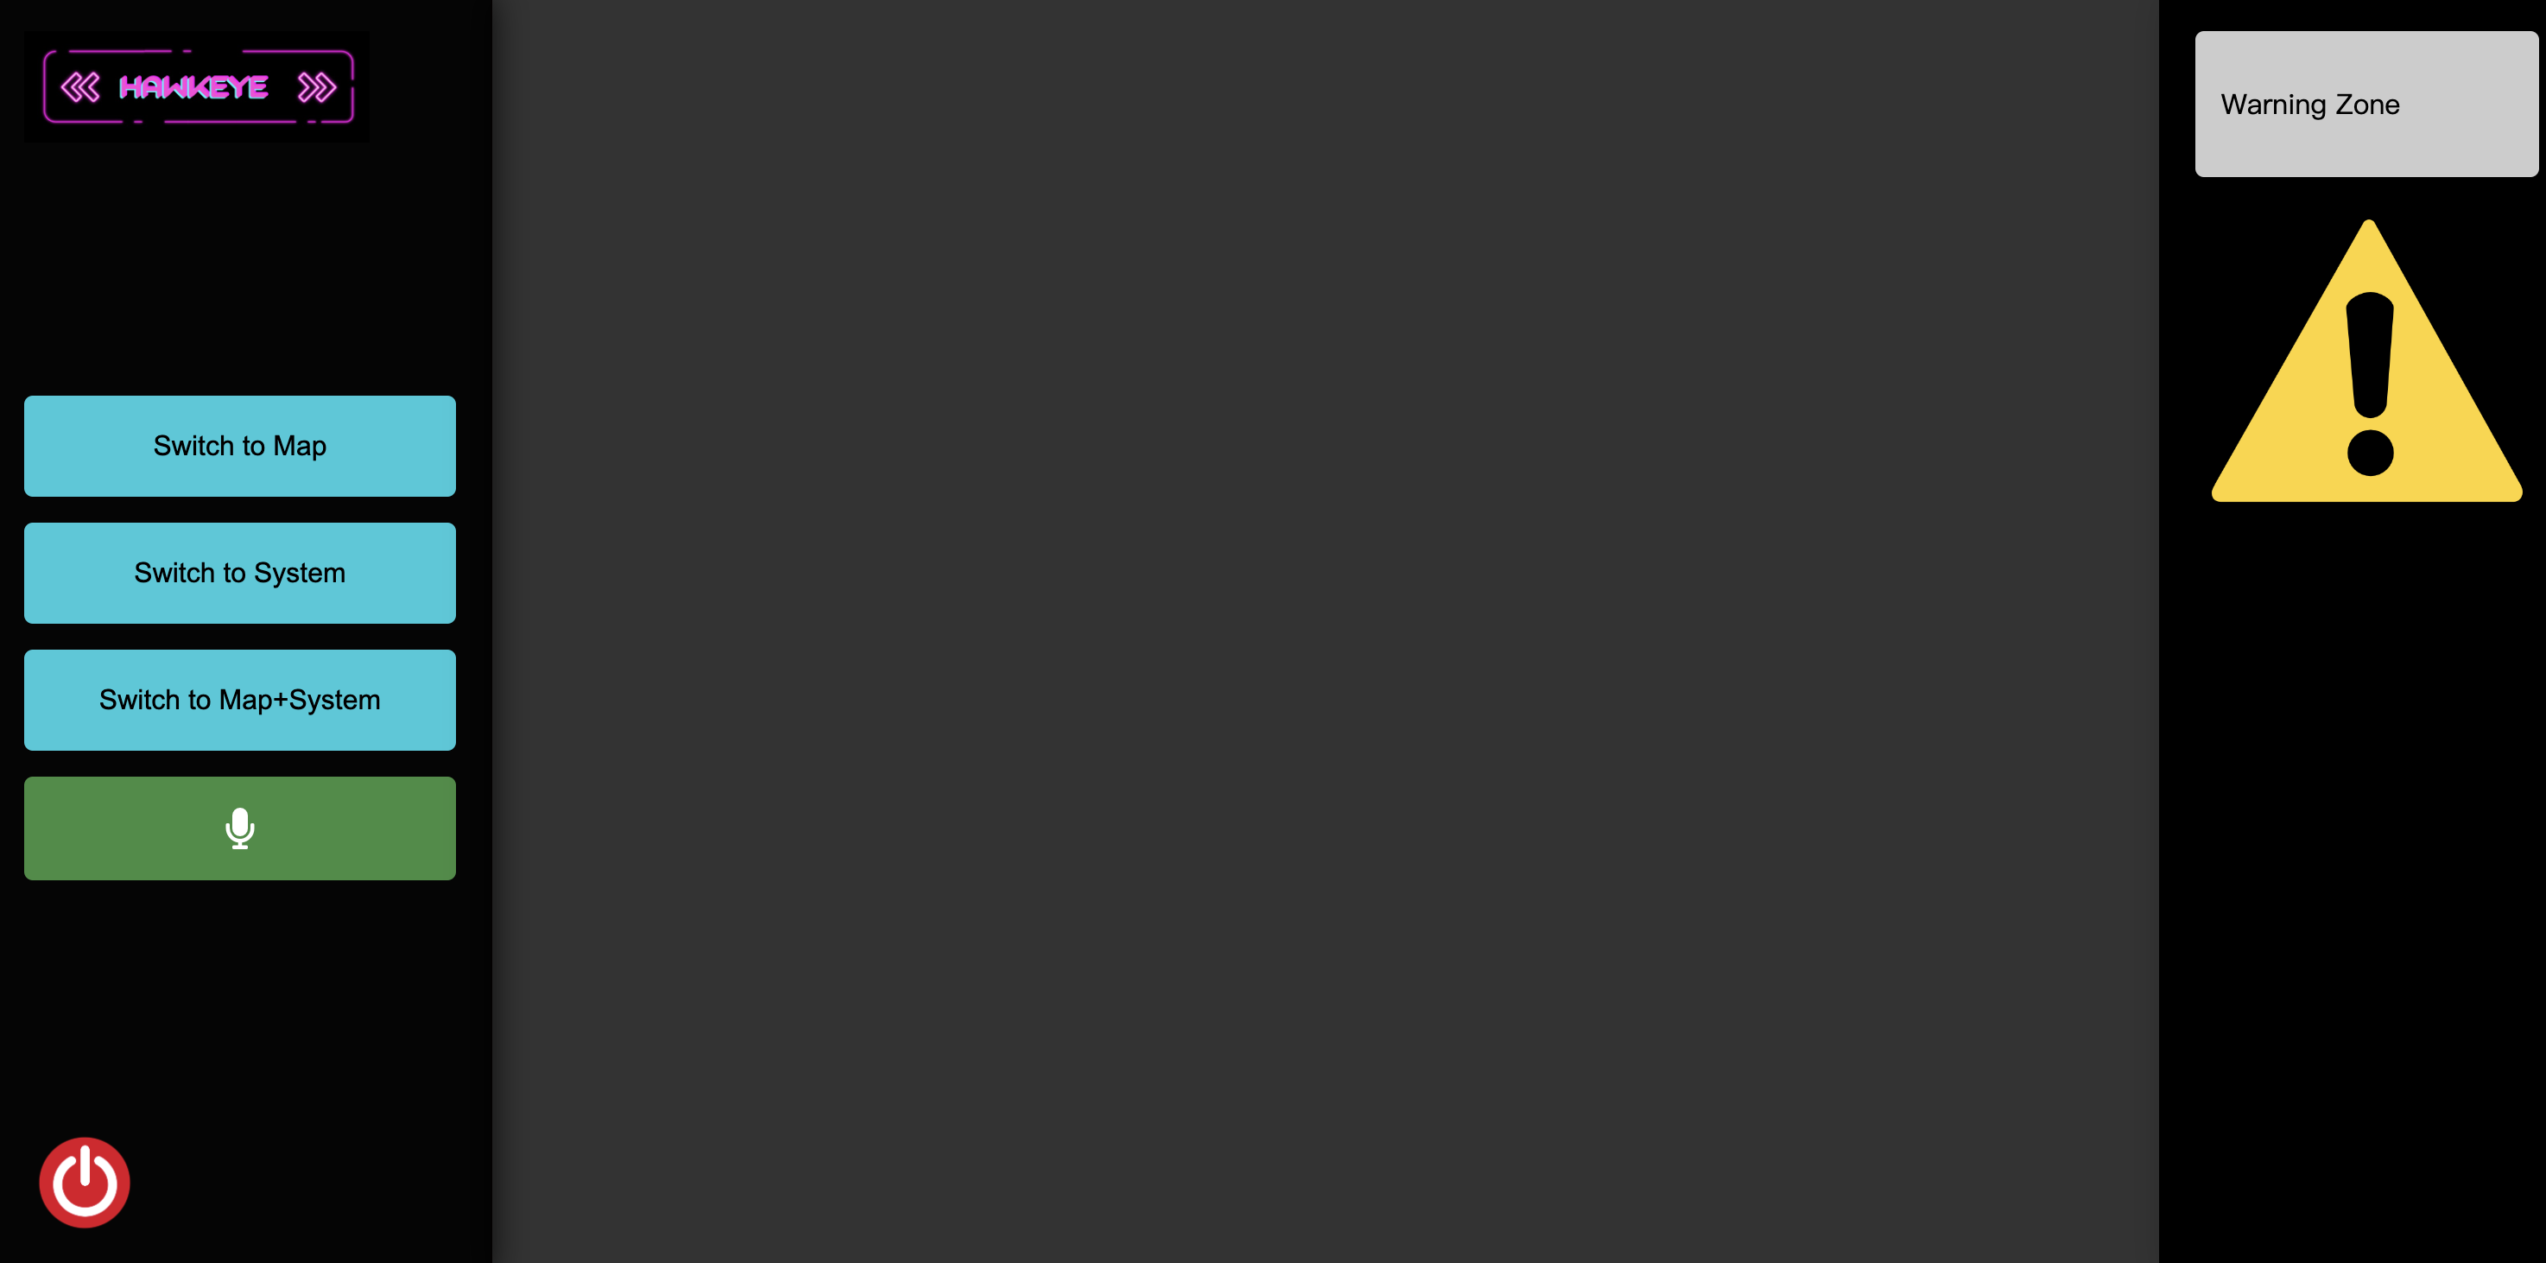
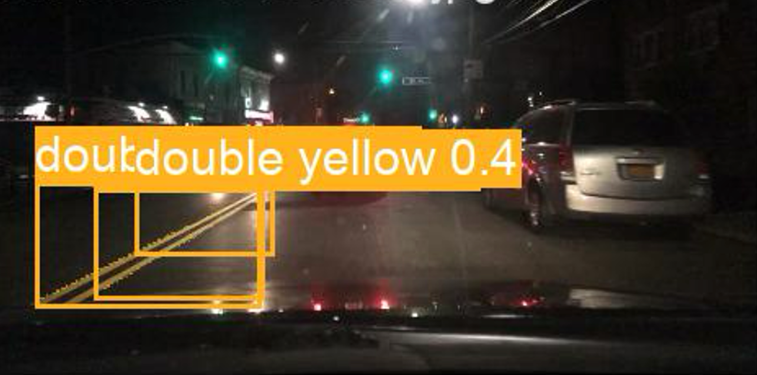
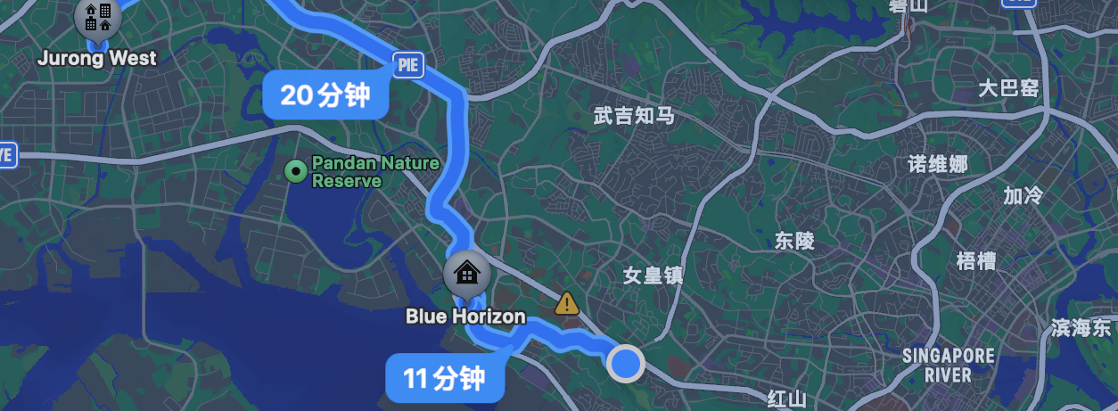
2.5 System User Interface
Notes:
This is what our system front-end interface looks like, perhaps it will be in the AR glasses in the future. The left part contains several switch buttons/ This screenshot shows the user interface of both the map and the system. The right panel alert will show up if incoming traffic is detected from behind. The middle section is our main functional display area, where it connects to the backend of our system and process data simultaneously.

Slide 36
Part 3 – Wrap-uP
Summarizations of the project

Slide 37
3.1 Conclusions
In the 'Hawkeye' project, we meticulously crafted a smart vision system that harnesses the power of advanced computer vision and machine learning techniques.
With a camera mounted on a helmet, the system excels in blind-spot detection through multi-object tracking.
It ensures the user stays on the right track using the drivable area and lane segmentation technologies.
We utilized the robust pre-trained YOLOv8 backbone, which we fine-tuned on the BDD100K dataset for each specific task.
By strategically employing transfer learning, we adapted our models to handle the comprehensive panoptic segmentation task.
This ensures that our system can flexibly meet a wide range of needs and achieve commendable performance in testing.

Slide 38
3.2 Limitations
Despite the promising results, our system encounters several limitations that need addressing in future work:
First, the availability of around 100K samples constrained our model fine-tuning. During training, we observed that the models tend to overfit after approximately ten epochs, struggling to achieve higher mean Average Precision (mAP) during evaluation.
Secondly, the system's inference logic follows a naive sequential approach, processing each of the three models individually. This method is less efficient and harms real-time performance, as it does not leverage parallel processing capabilities.
Even though we applied TTA to mitigate the effects of poor illumination and inclement weather conditions, the model can still become unstable and even fail under such circumstances. It highlights the need for further improvements to ensure consistent performance in adverse conditions.

Slide 39
3.2 Future Work
To enhance the capabilities and performance of the "Hawkeye" system, we plan to involve the following improvements and developments:
Multitask Learning Implementation: We aim to implement a comprehensive multitask learning system. Although we have made significant progress, we face some internal conflicts with the Ultralytics framework. Resolving these conflicts will be a priority to achieve seamless multitask learning, releasing full system's potential efficiency and accuracy.
Parallel Processing for Inference: We will redesign the inference logic to enable parallel processing of frames. By leveraging parallelism, we can significantly reduce latency and improve the system's real-time capabilities.
By addressing these limitations and pursuing these future enhancements, we aim to build a more robust and efficient "Hawkeye" system capable of delivering superior performance and reliability in real-world applications.

Slide 40
Selective References
[1] Wu, D. et al. (2022) Yolop: You only look once for panoptic driving perception, arXiv.org. Available at: https://arxiv.org/abs/2108.11250 (Accessed: 19 May 2024).
[2] Zhao, Y.; Bai, L.; Lyu, Y.; Huang, X. Camera-Based Blind Spot Detection with a General Purpose Lightweight Neural Network. Electronics 2019, 8, 233. https://doi.org/10.3390/electronics8020233
[3] E. Tavanti, A. Rizik, A. Fedeli, D. D. Caviglia and A. Randazzo, "A Short-Range FMCW Radar-Based Approach for Multi-Target Human-Vehicle Detection," in IEEE Transactions on Geoscience and Remote Sensing, vol. 60, pp. 1-16, 2022, Art no. 2003816, doi: 10.1109/TGRS.2021.3138687.
[4] Voigtlaender, P., Krause, M., Osep, A., Luiten, J., Sekar, B.B.G., Geiger, A. & Leibe, B. MOTS: Multi-Object Tracking and Segmentation. In Proceedings IEEE Conf. on Computer Vision and Pattern Recognition (CVPR), 2019.
[5] Ristani, E., Solera, F., Zou, R., Cucchiara, R. & Tomasi, C. Performance Measures and a Data Set for Multi-Target, Multi-Camera Tracking. In ECCV workshop on Benchmarking Multi-Target Tracking, 2016.
[6] Li, Y., Huang, C. & Nevatia, R. Learning to associate: HybridBoosted multi-target tracker for crowded scene. In Proceedings of the IEEE Computer Society Conference on Computer Vision and Pattern Recognition, 2009.
[7] Papers with code - BDD100K dataset. Dataset | Papers With Code. (n.d.). https://paperswithcode.com/dataset/bdd100k
[8] Seita, D. (n.d.). BDD100K: A large-scale diverse driving video database. The Berkeley Artificial Intelligence Research Blog. https://bair.berkeley.edu/blog/2018/05/30/bdd/
[9] Yu, F. (n.d.). BDD100K. https://www.vis.xyz/bdd100k/

Slide 41
Thanks for watching

